Slide 1
Looking back on 2019-2020 FFA year

Slide 2
FFA Convention!

Slide 3
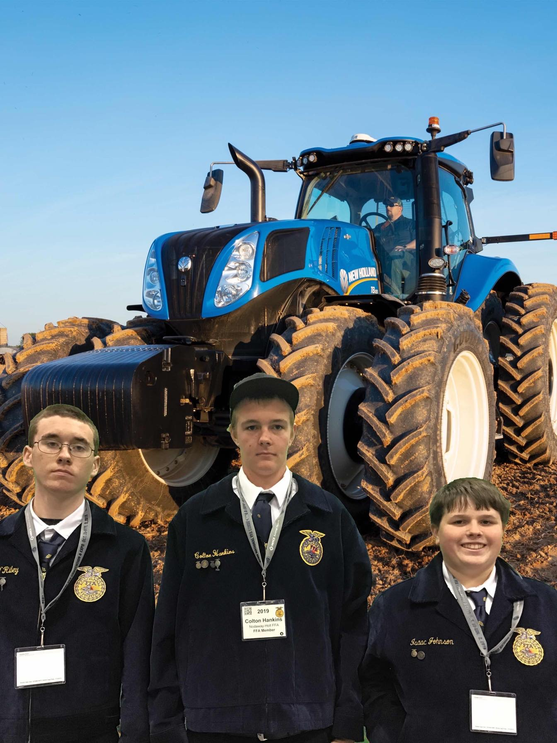
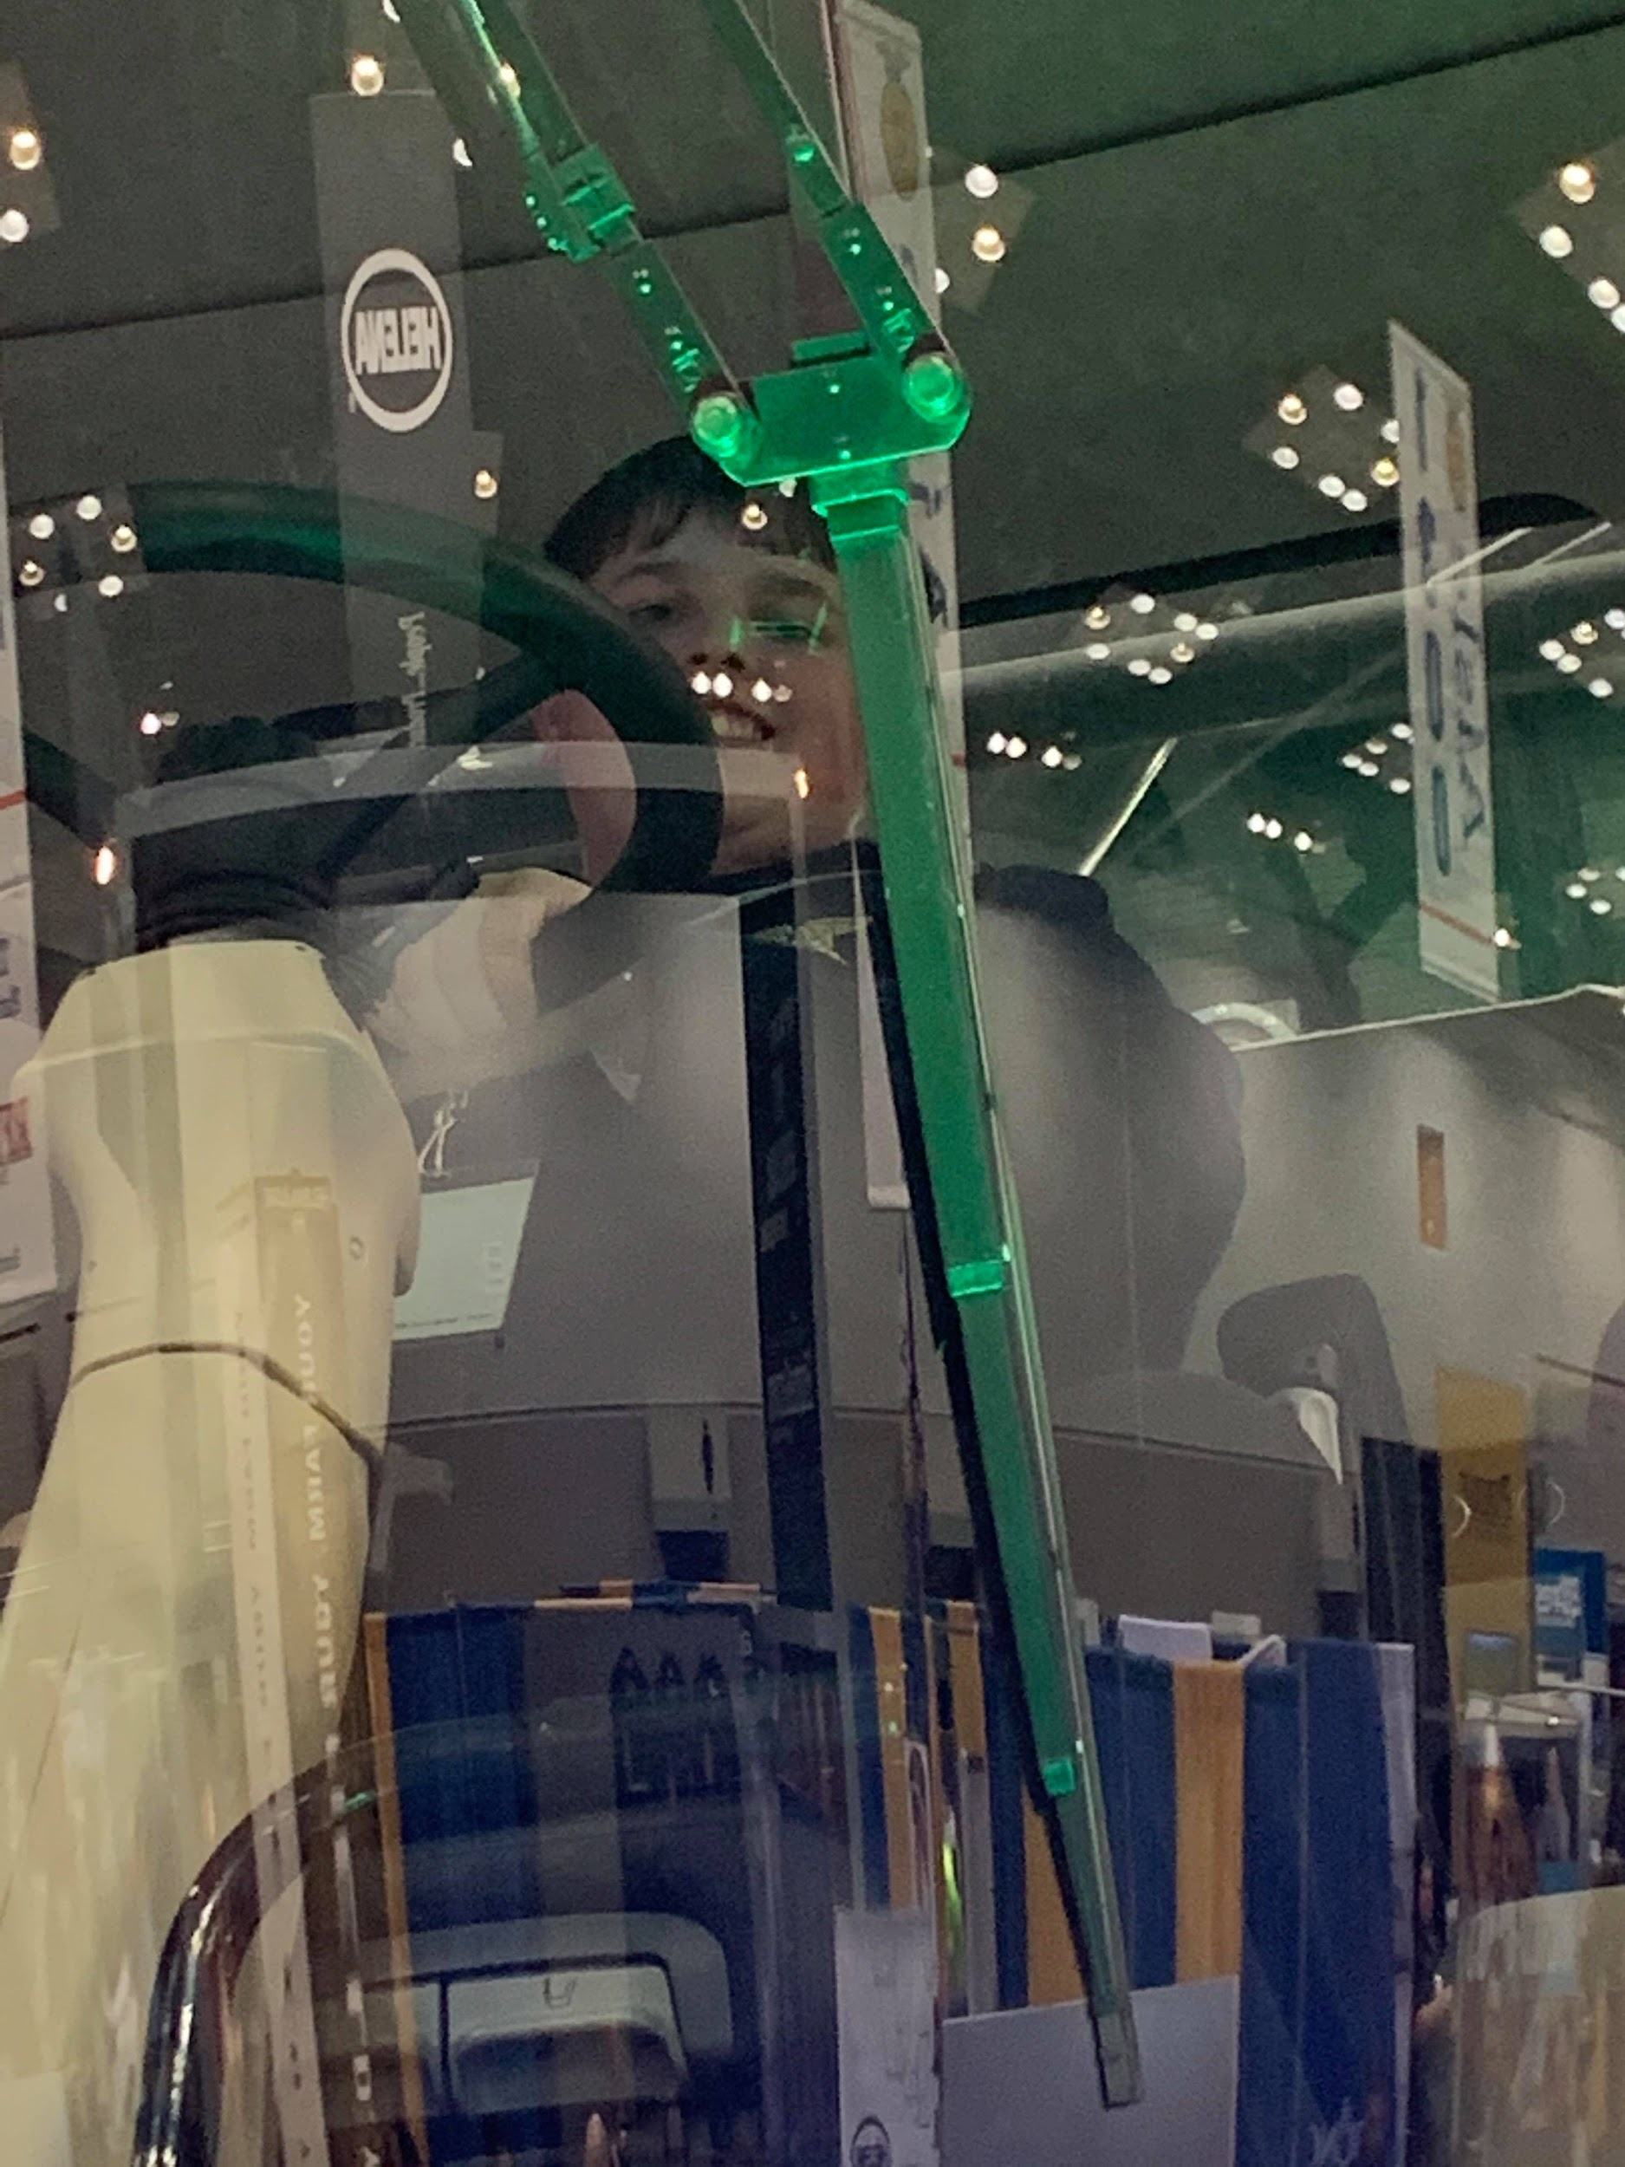
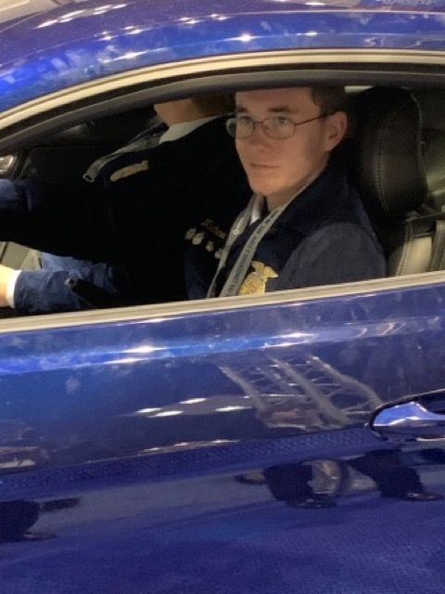
Instructions for use
Michael O’Riley, Colton Hankins, and Isaac Johnson
Michael O’Riley
Isaac Johnson
92 Annual FFA Convention in Indianapolis, IN

Slide 4
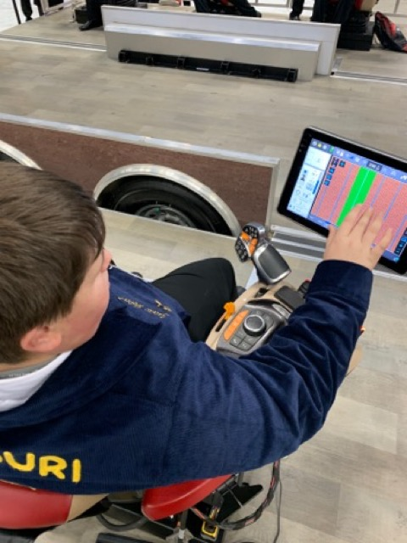
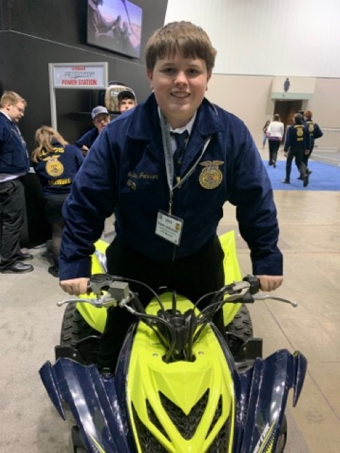
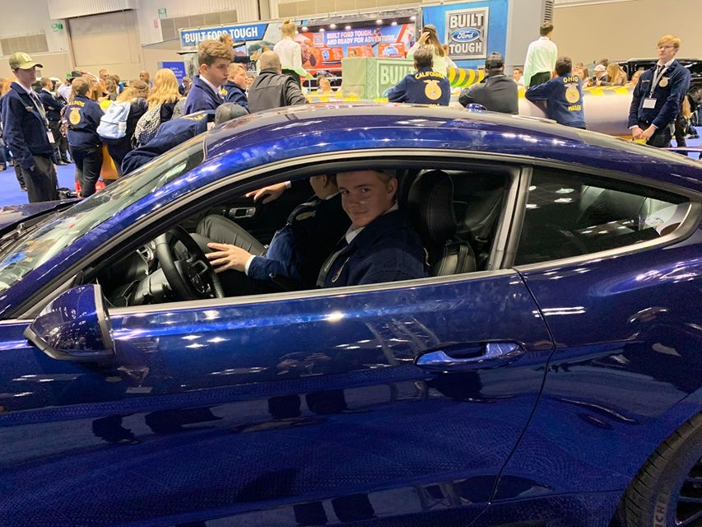
“I believe in the future of agriculture with a faith born not of words but of deeds.”
Colton Hankins
Isaac Johnson
Isaac Johnson

Slide 5
Fundraisers!

Slide 6
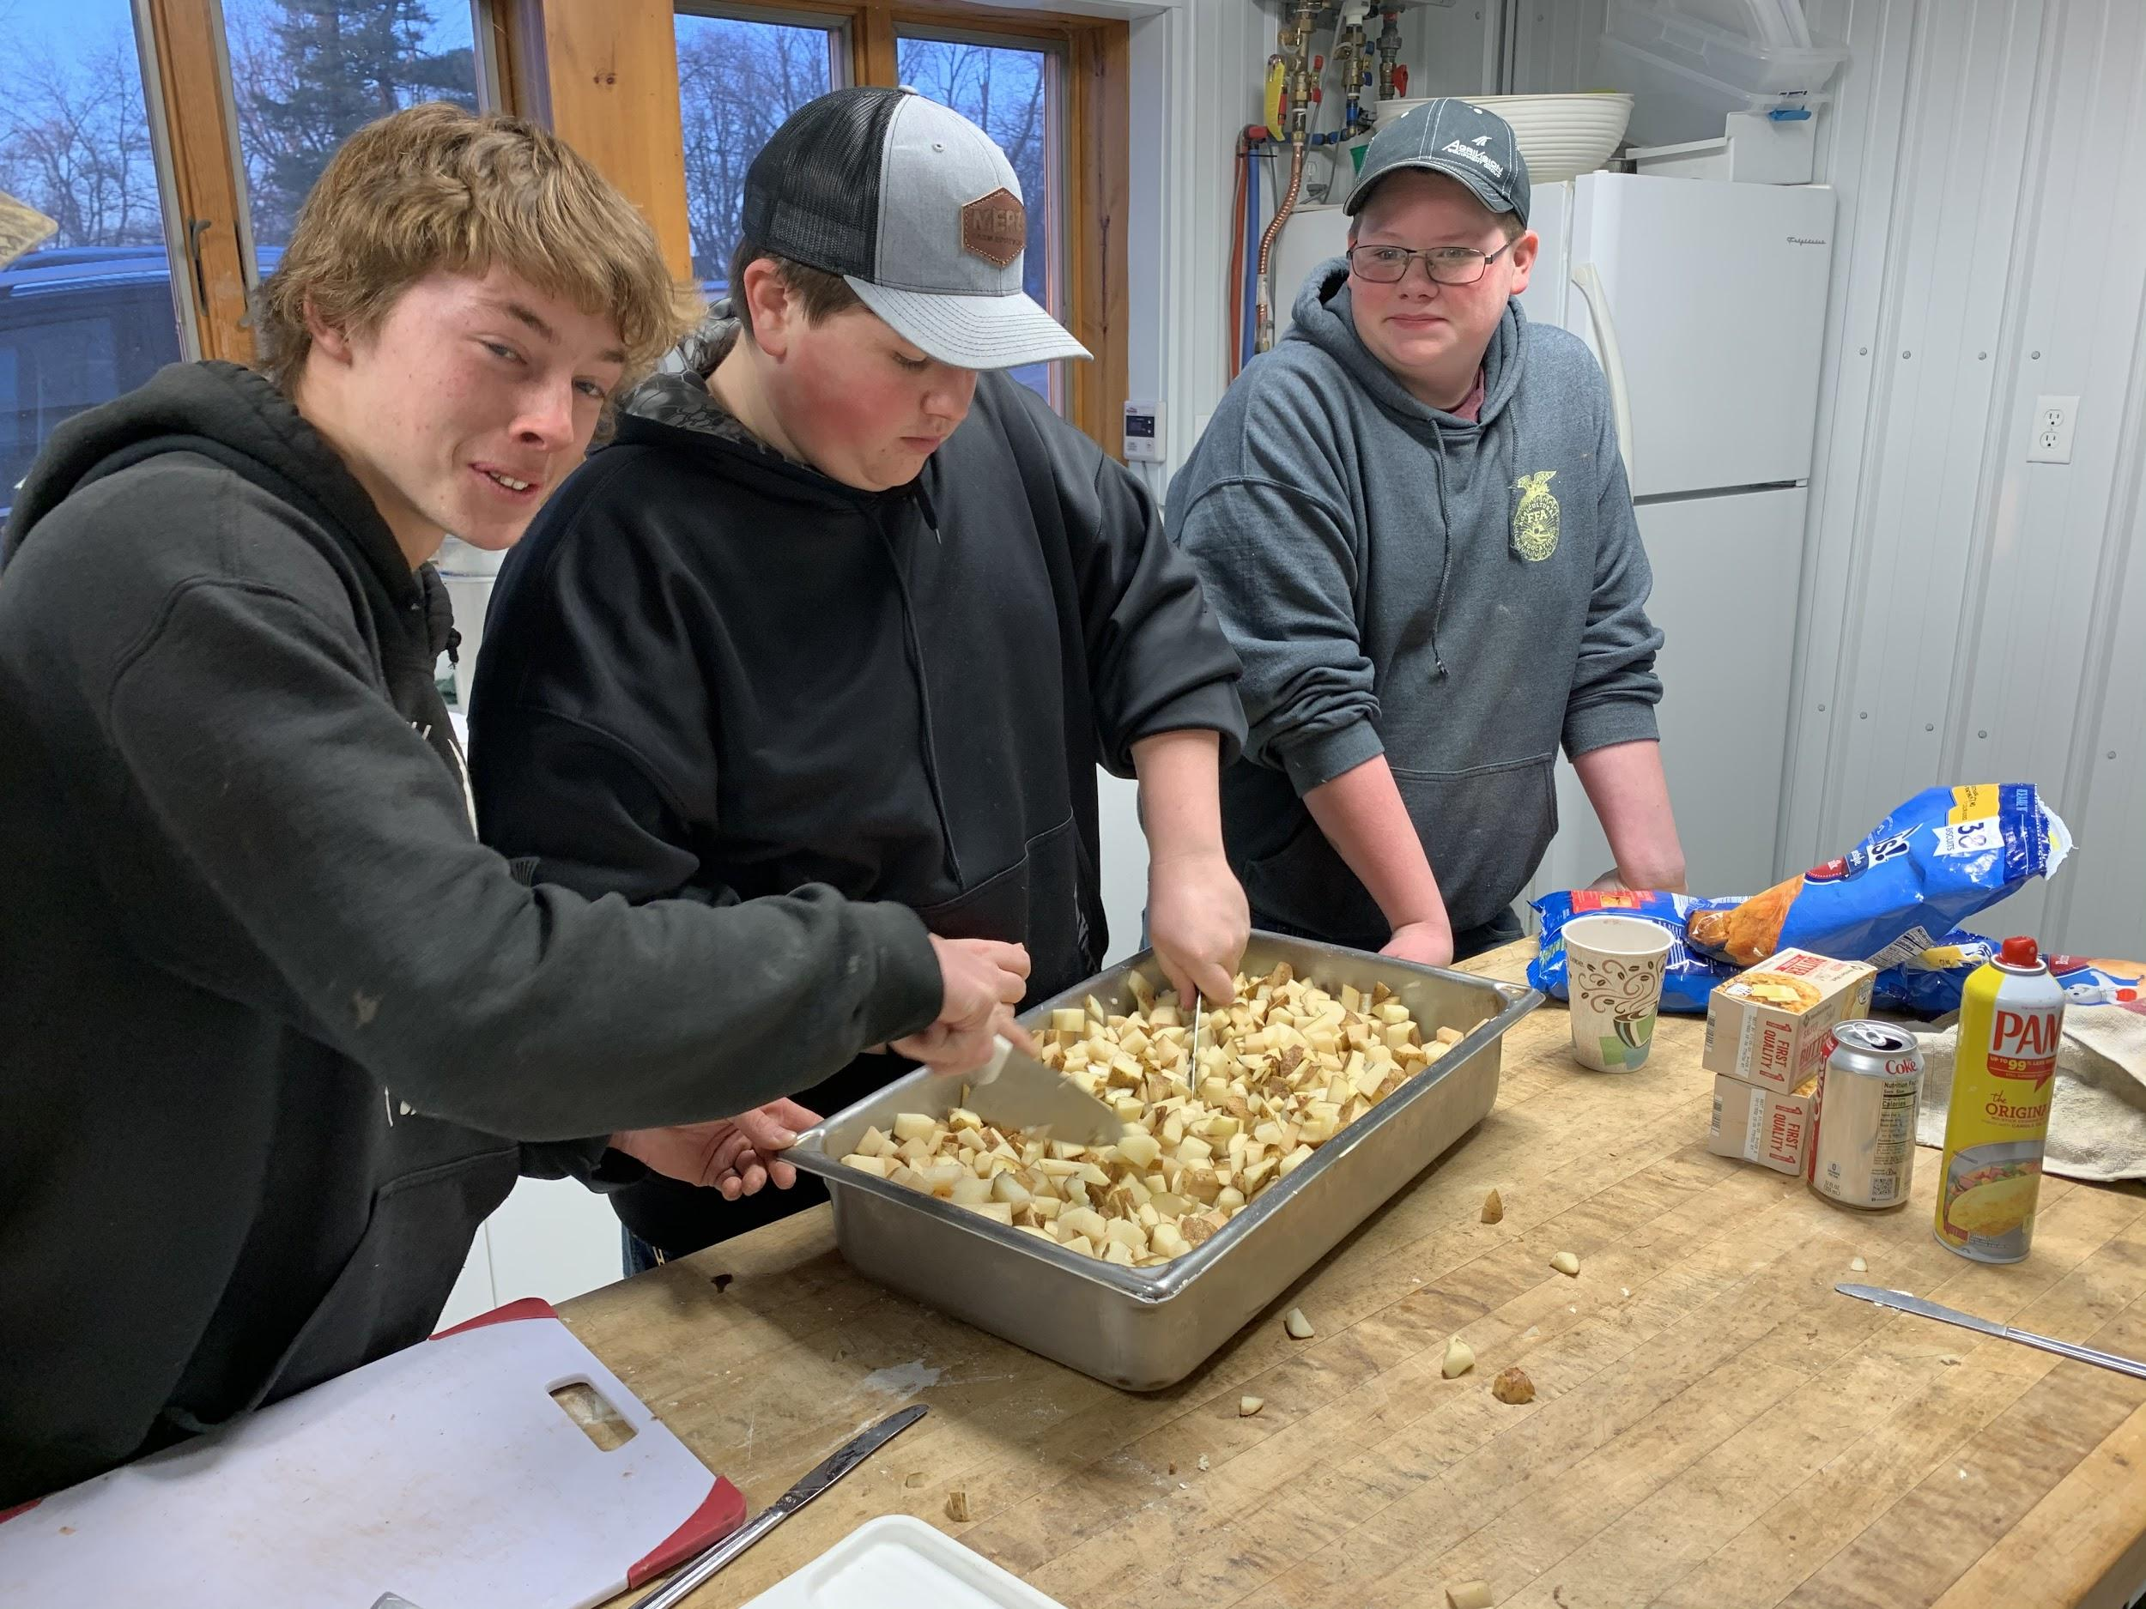
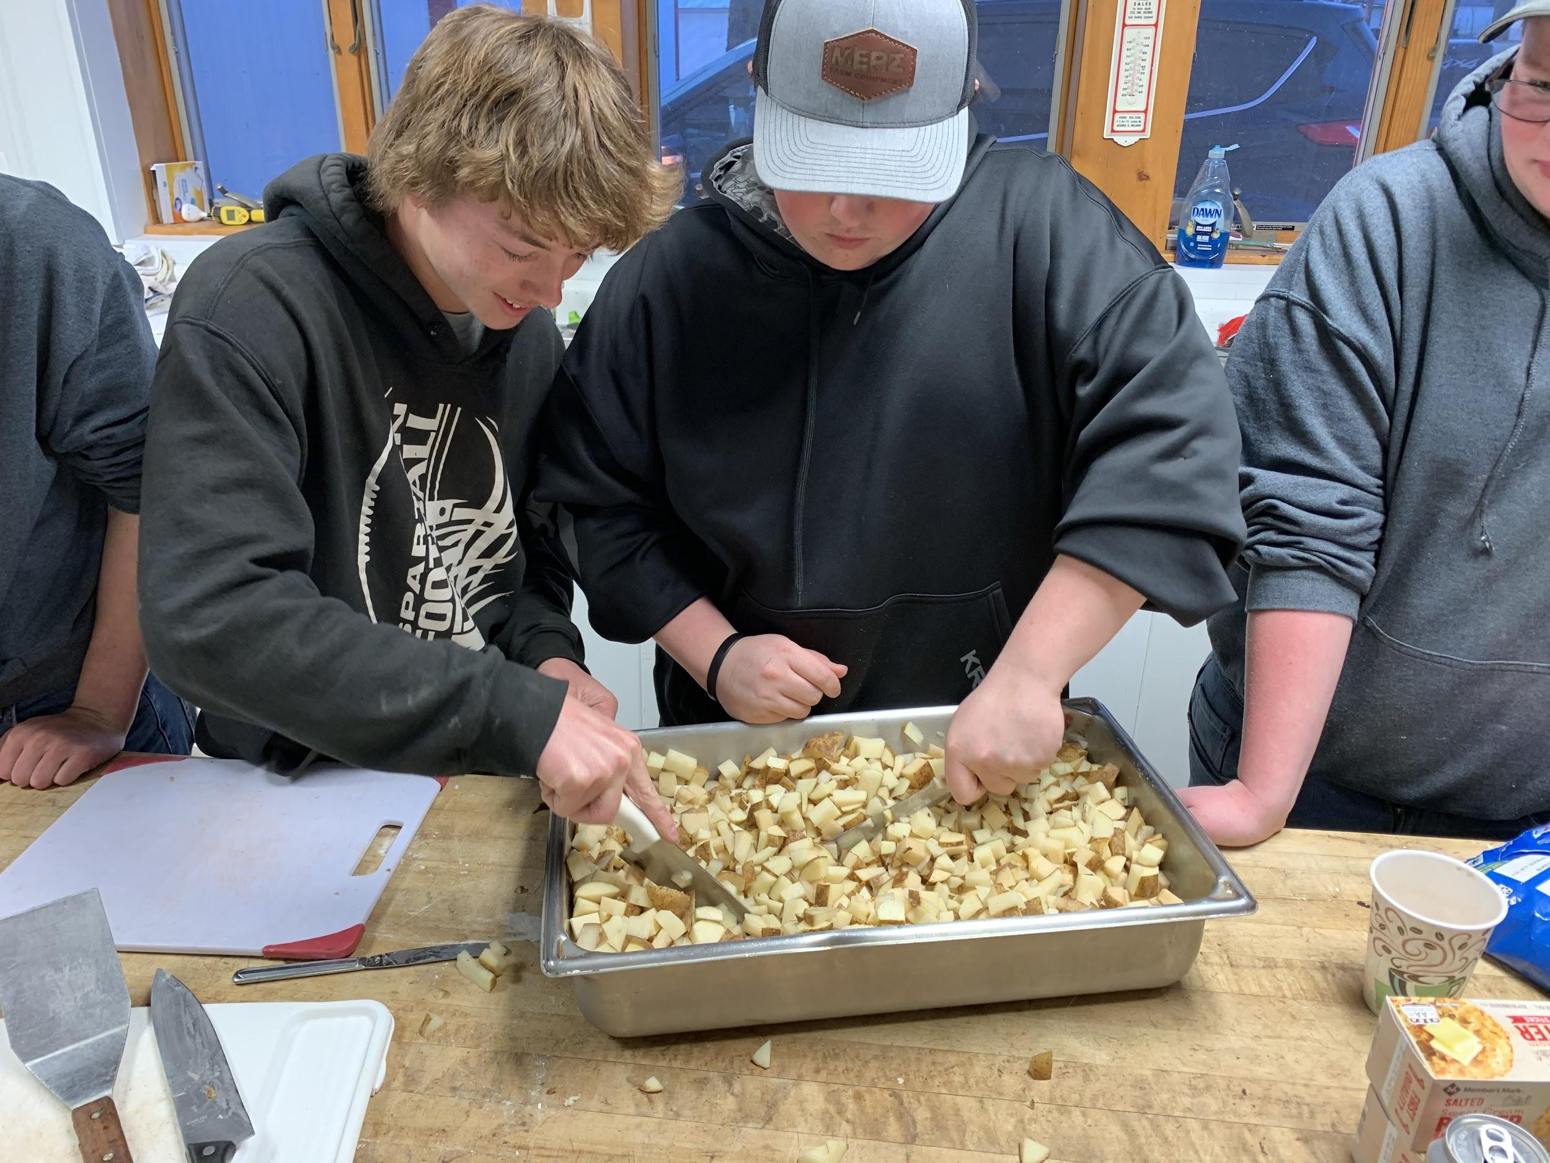
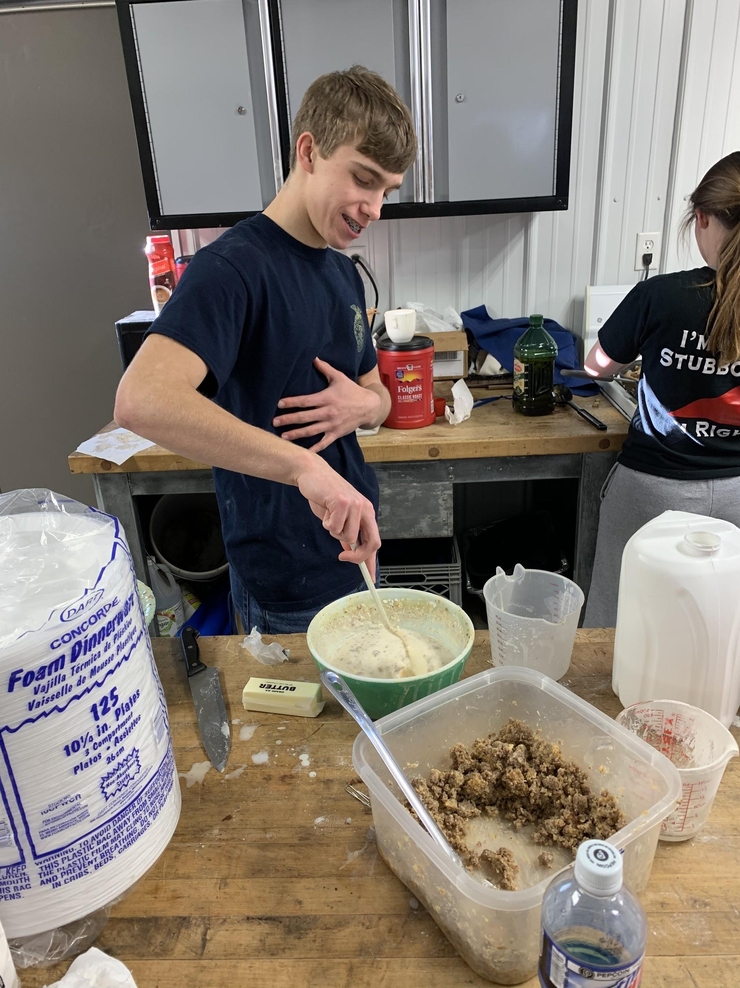
Good Morning! FFA Early Morning Breakfast.
Early bird gets the worm!
Clay Hanson
Kaiston Abrams,Isaac Johnson, and Trent Smock
Kaiston Abrams and Isaac Johnson

Slide 7
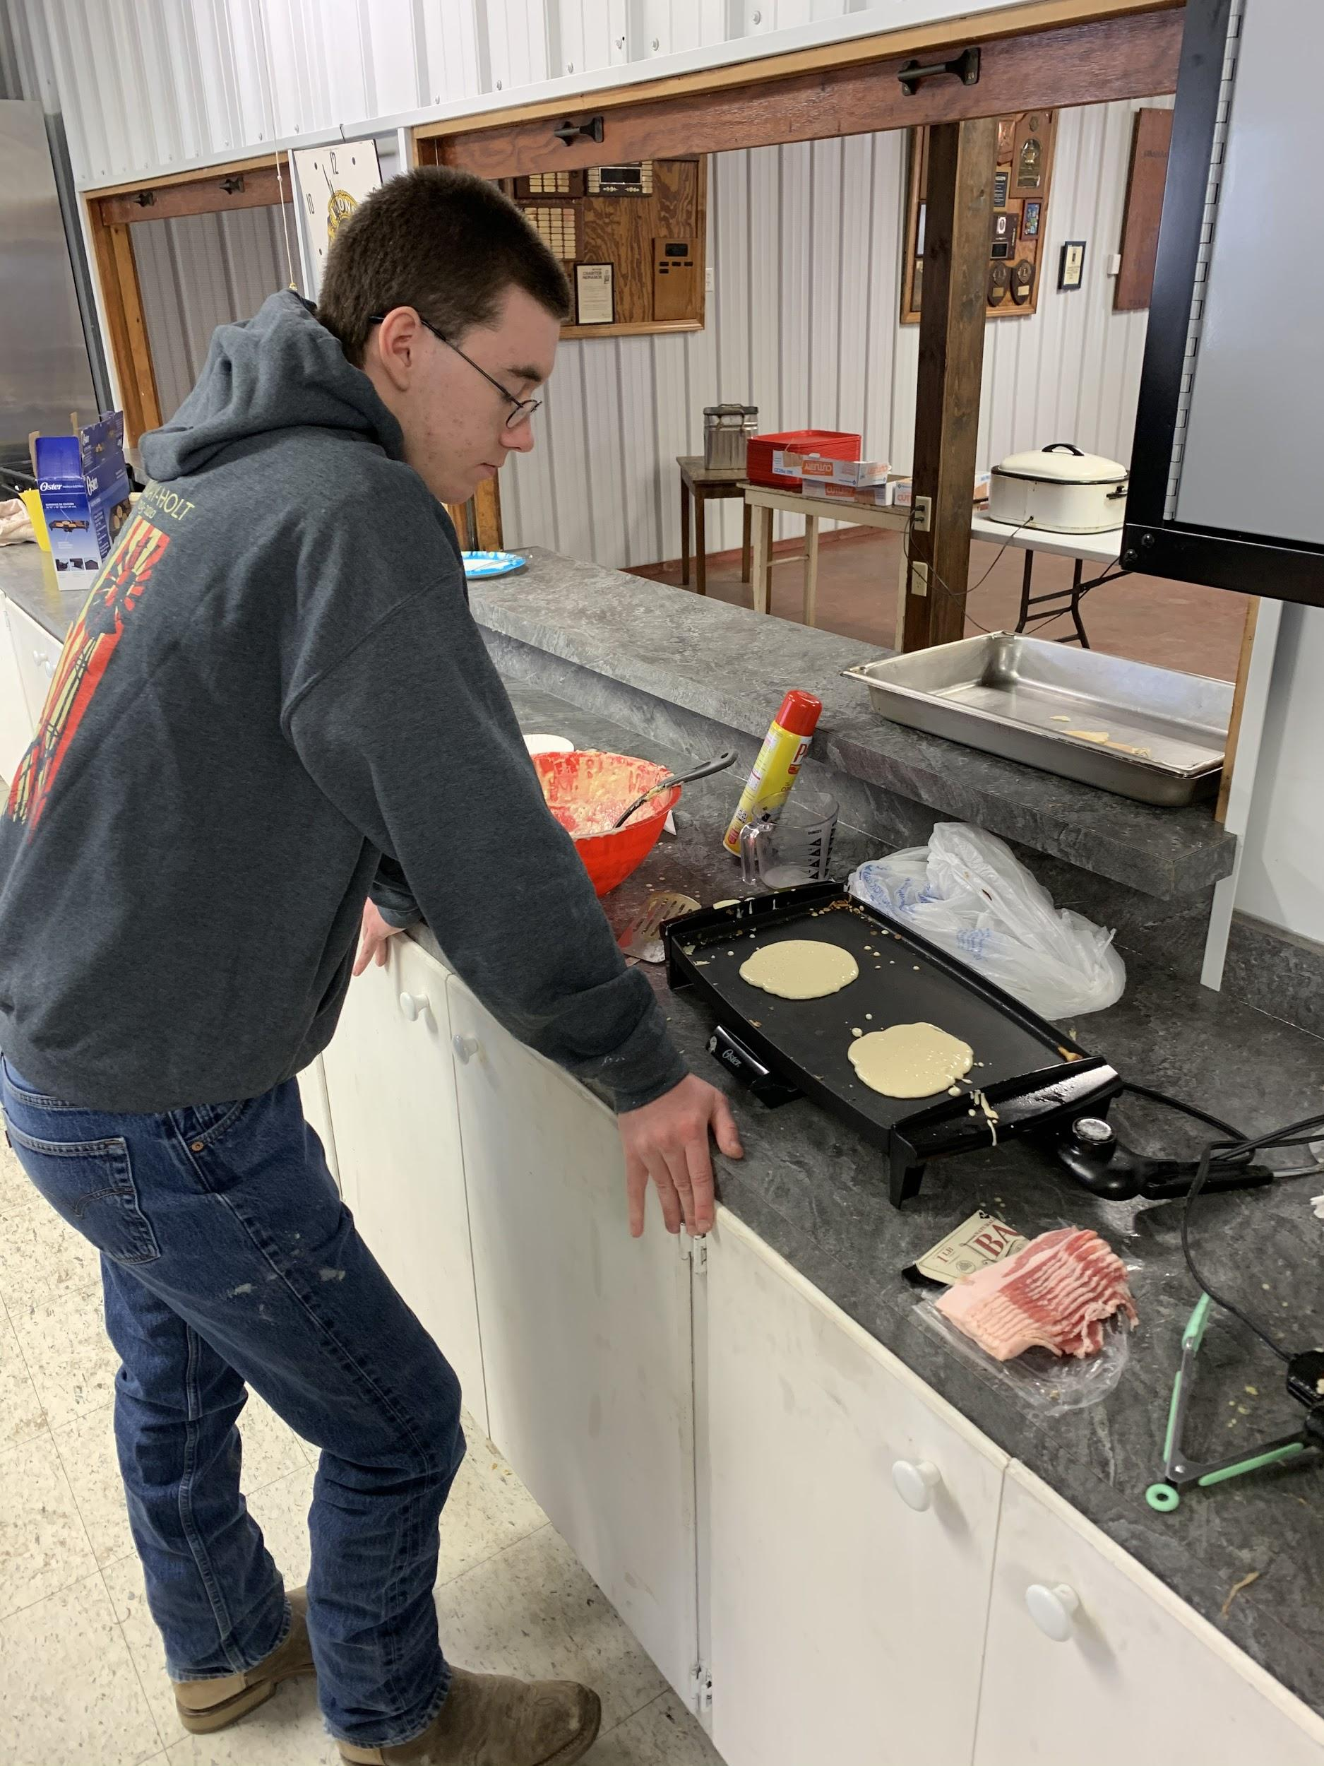
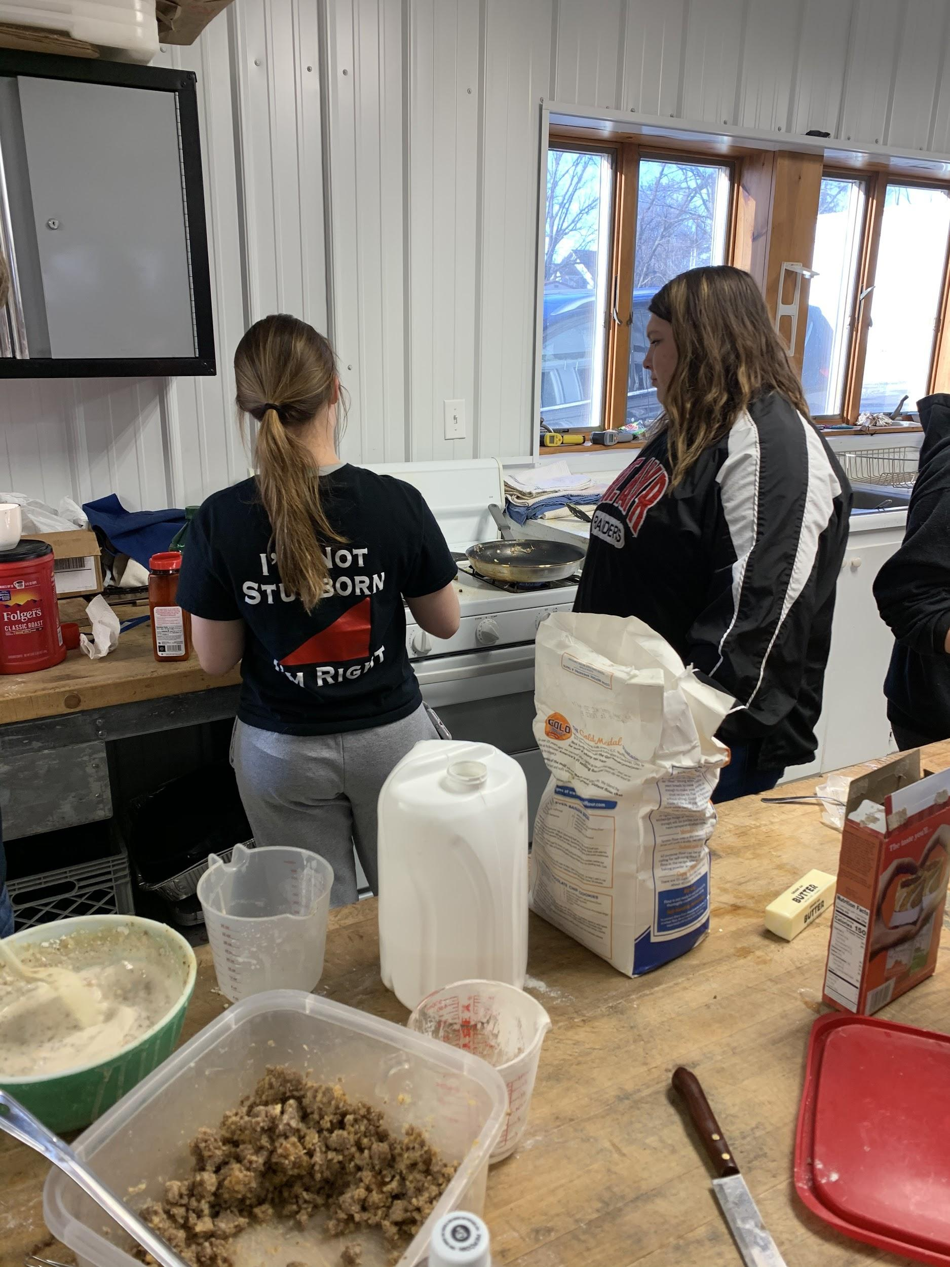
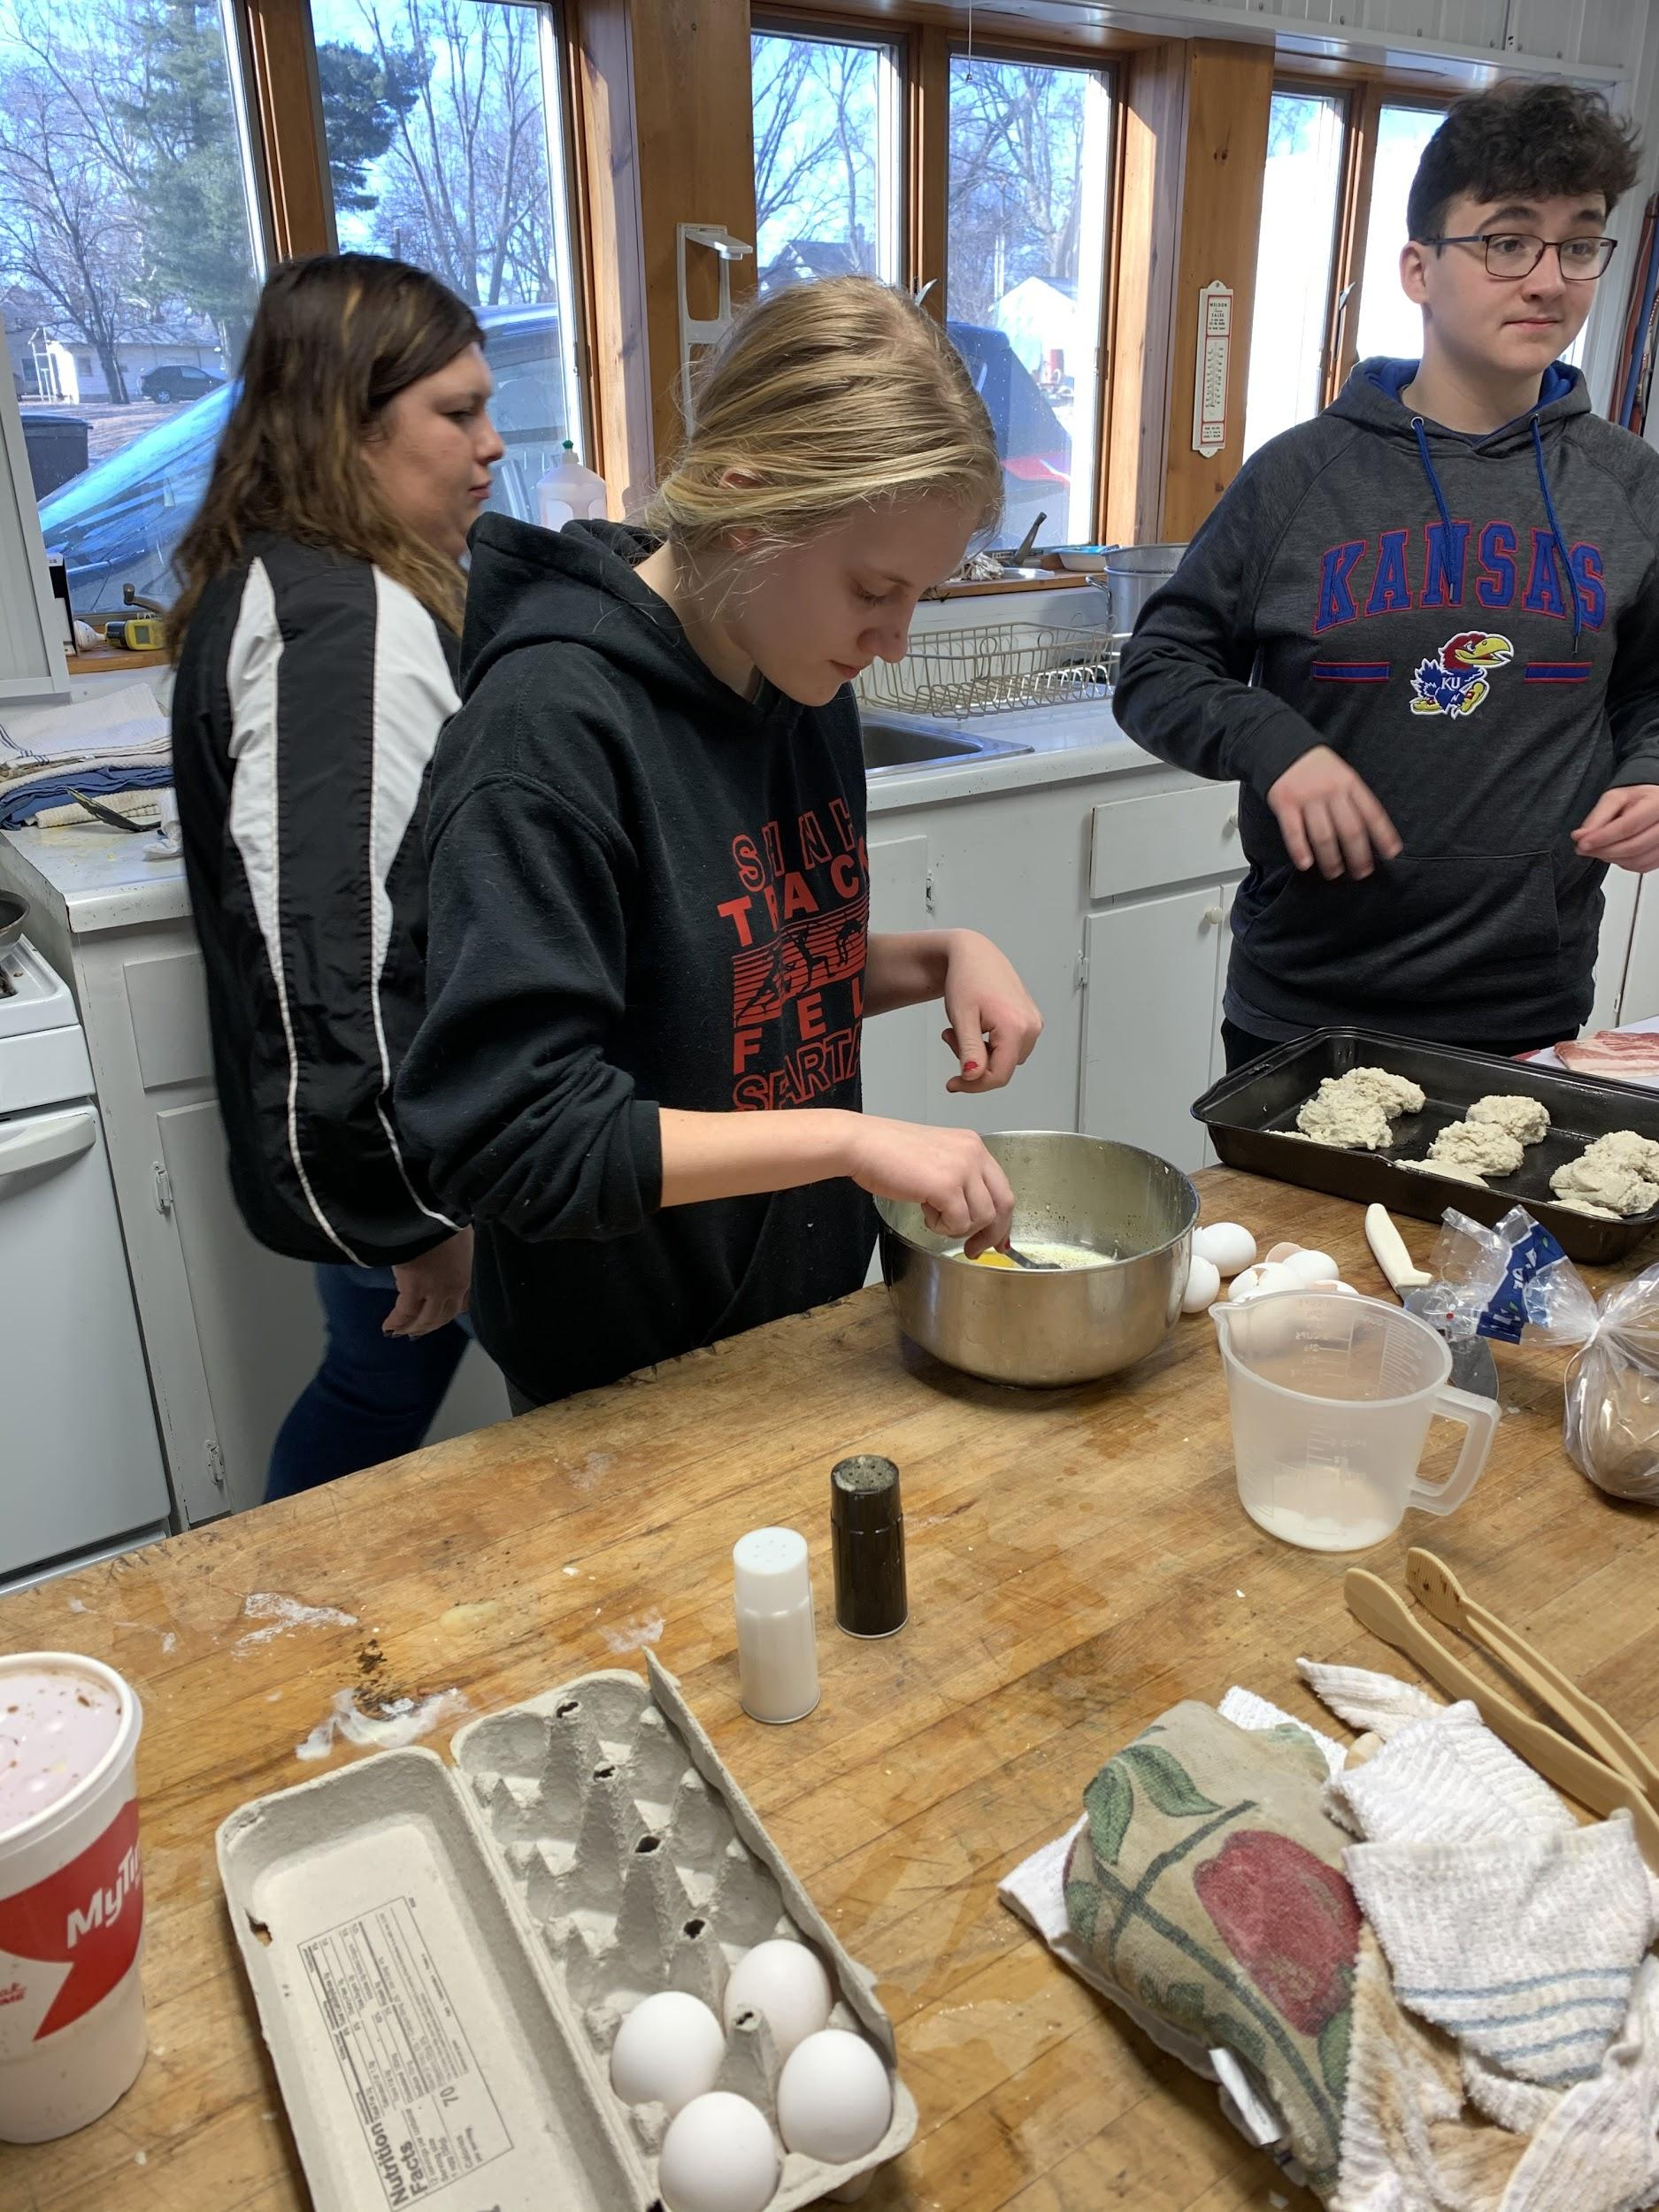
“Learning to do, Doing to learn, Earning to live, Living to surve”
Halle Clement and Ms. Holmes
Michael O’Riley
Morgan Wilmes

Slide 8
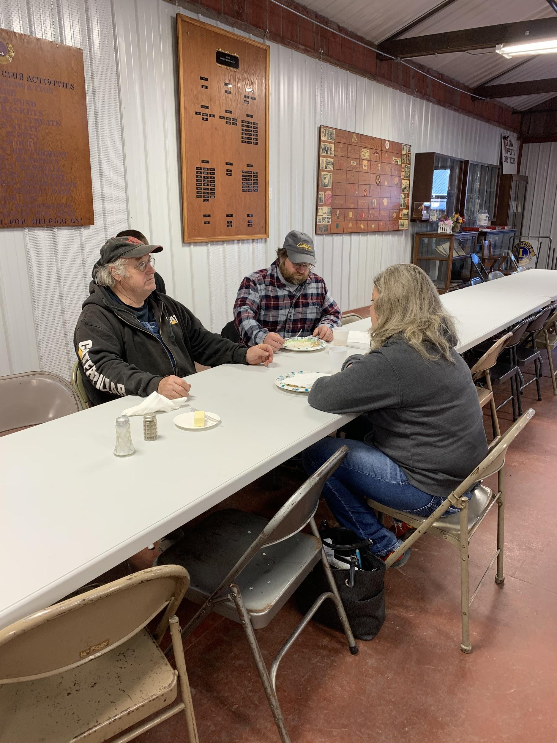
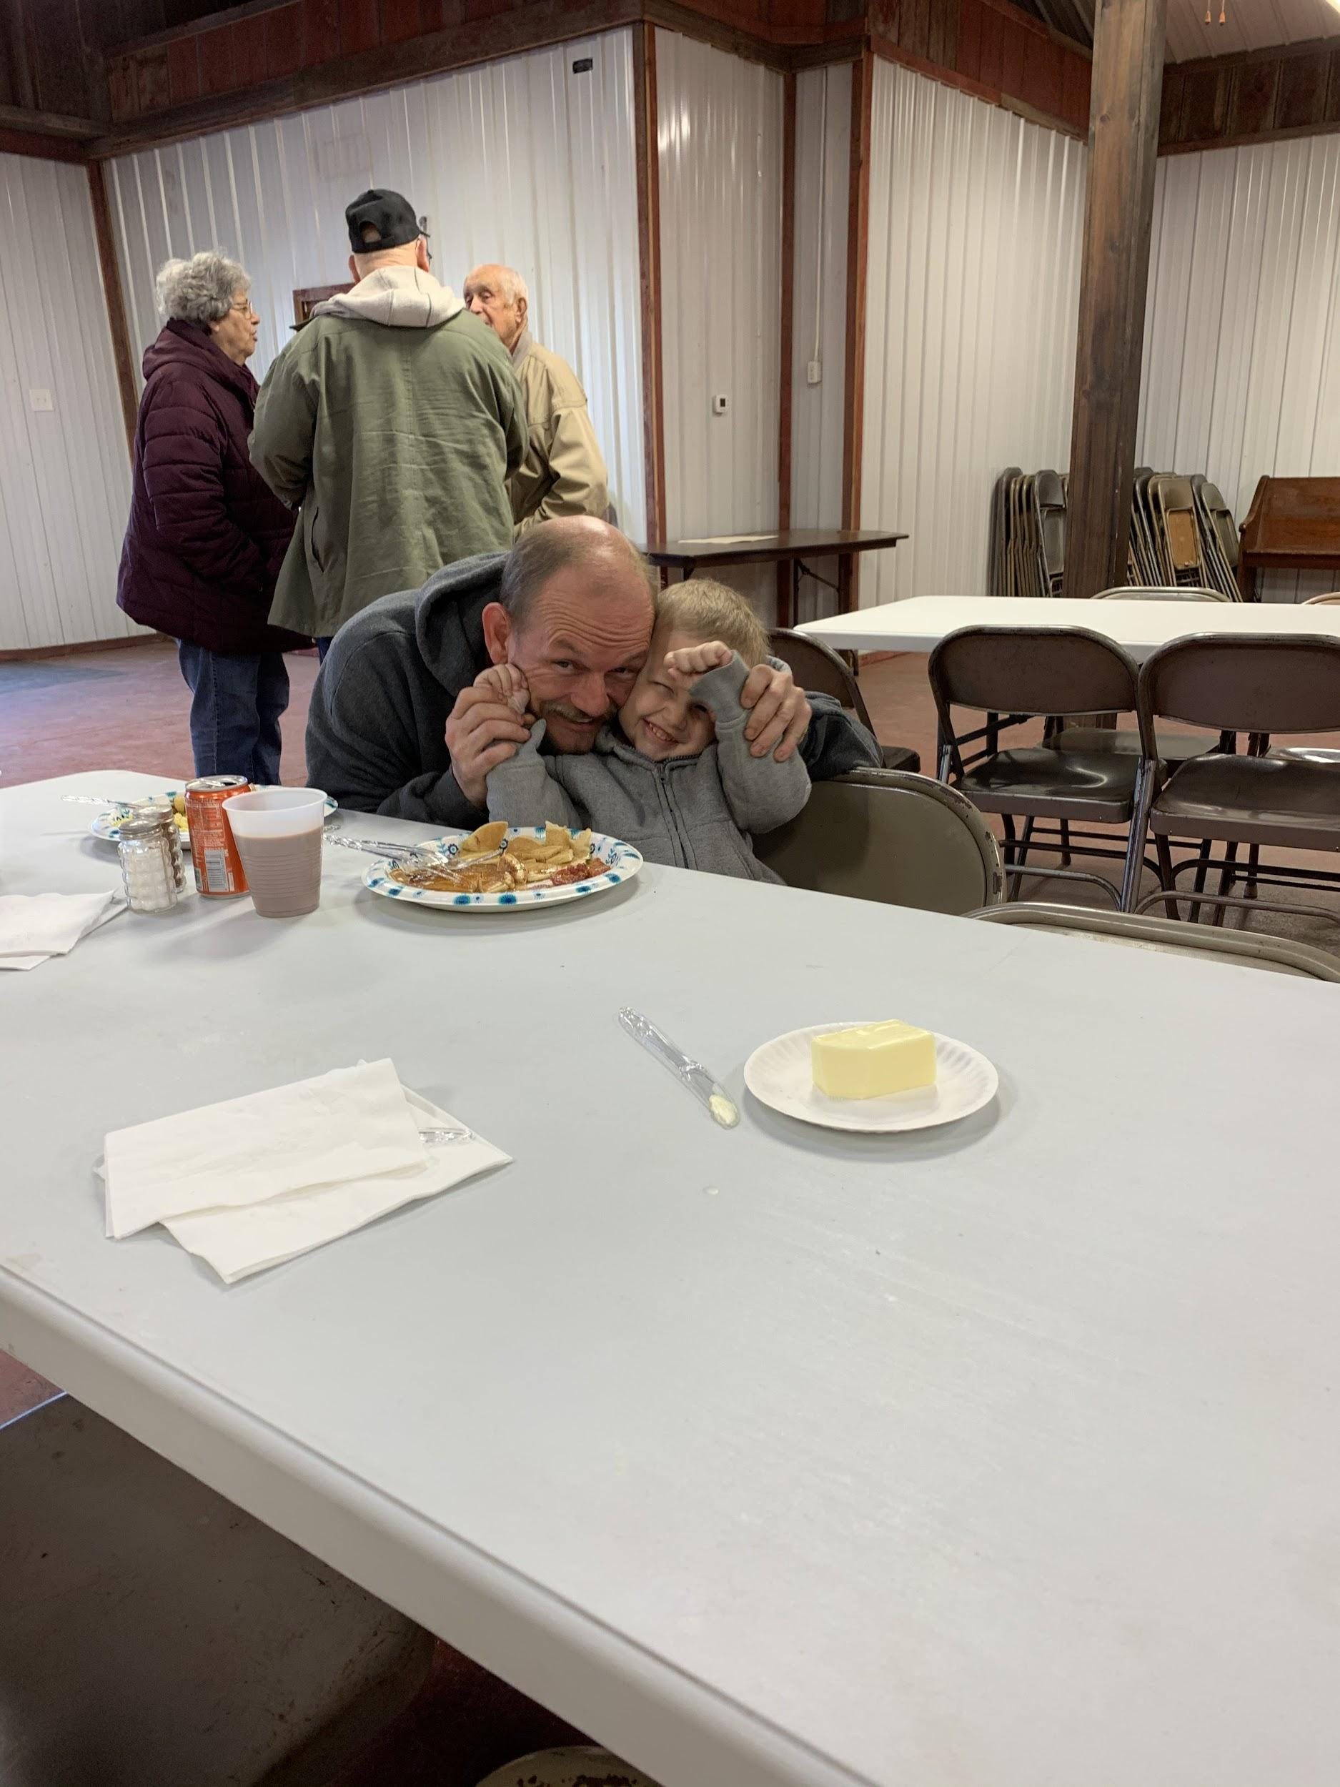
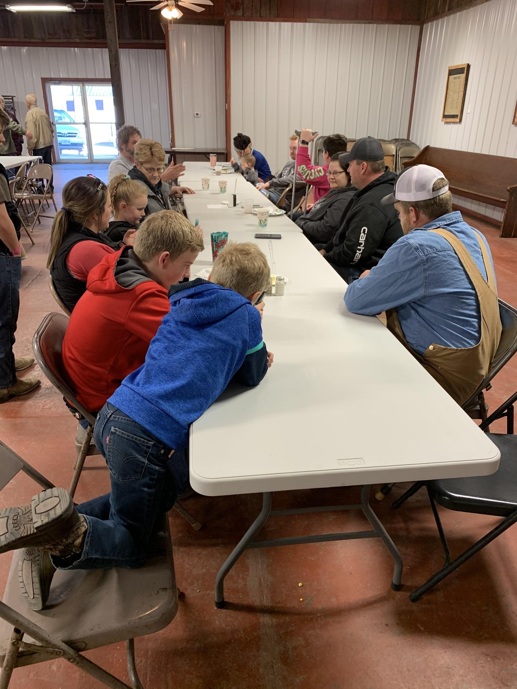
A special thank you to some of our supporters!

Slide 9
FFA WEEK!

Slide 10
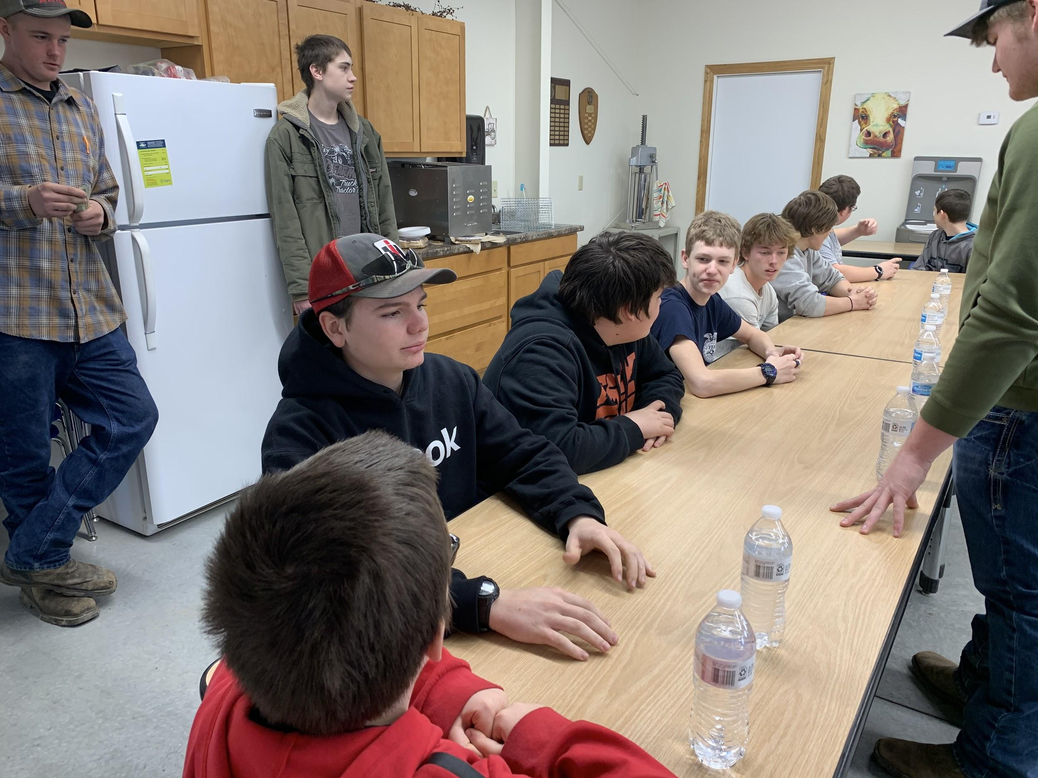
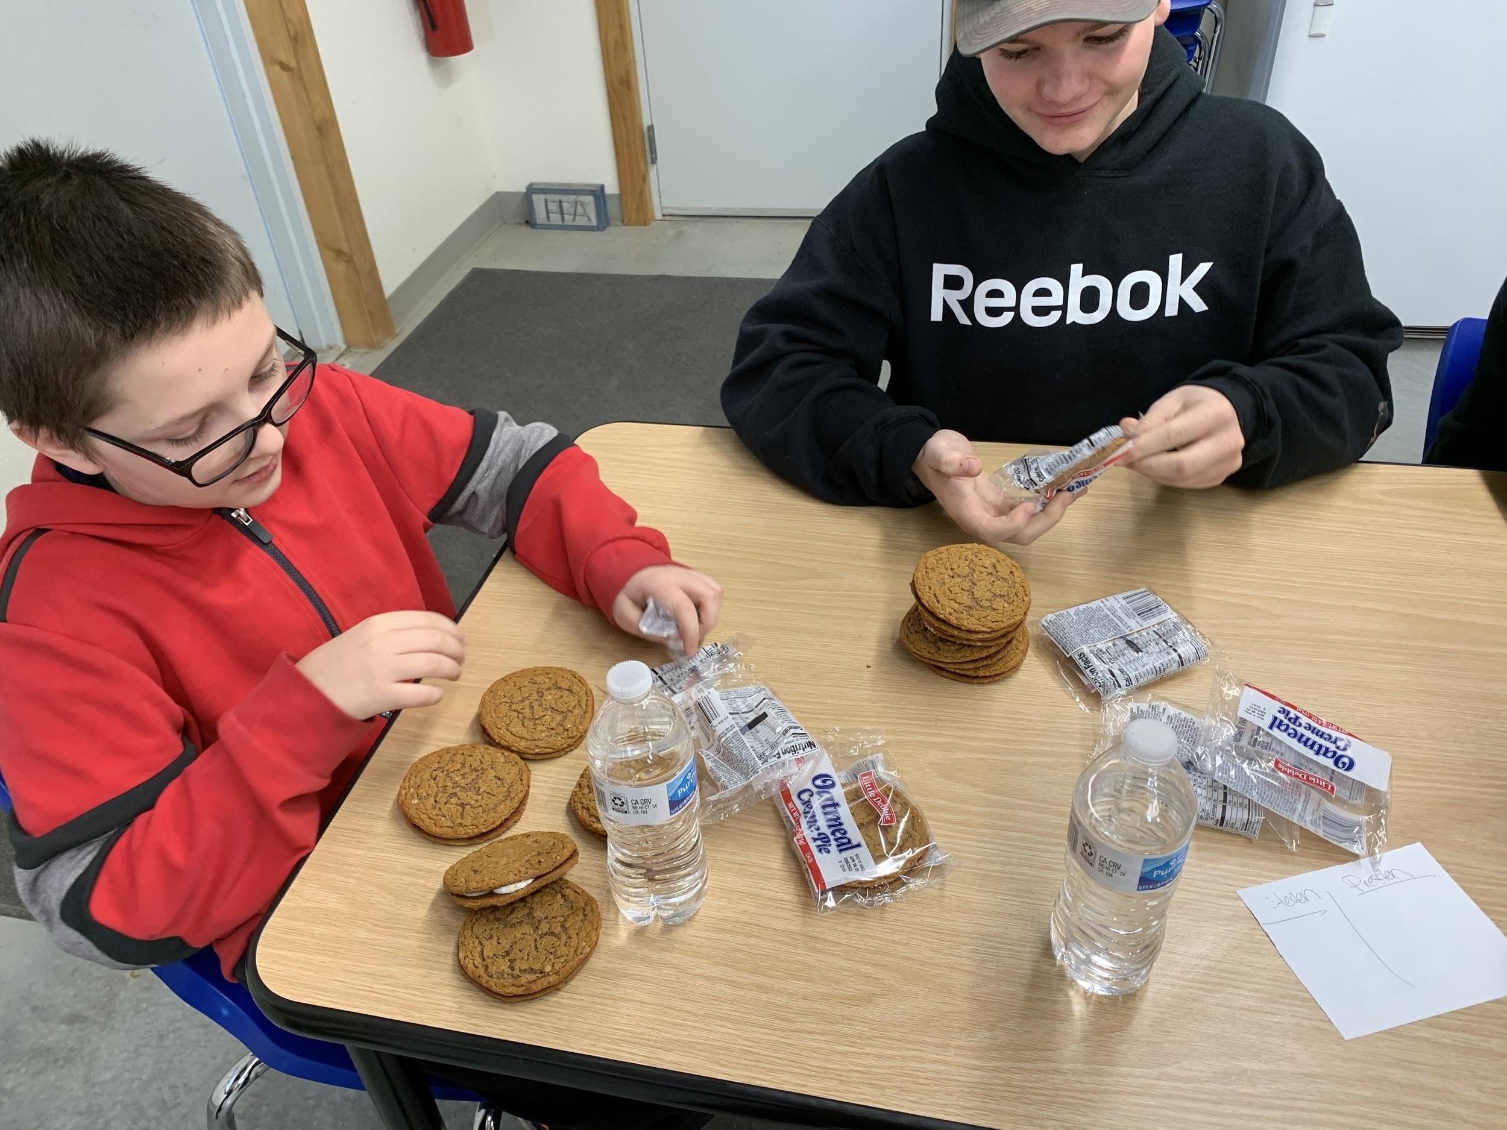
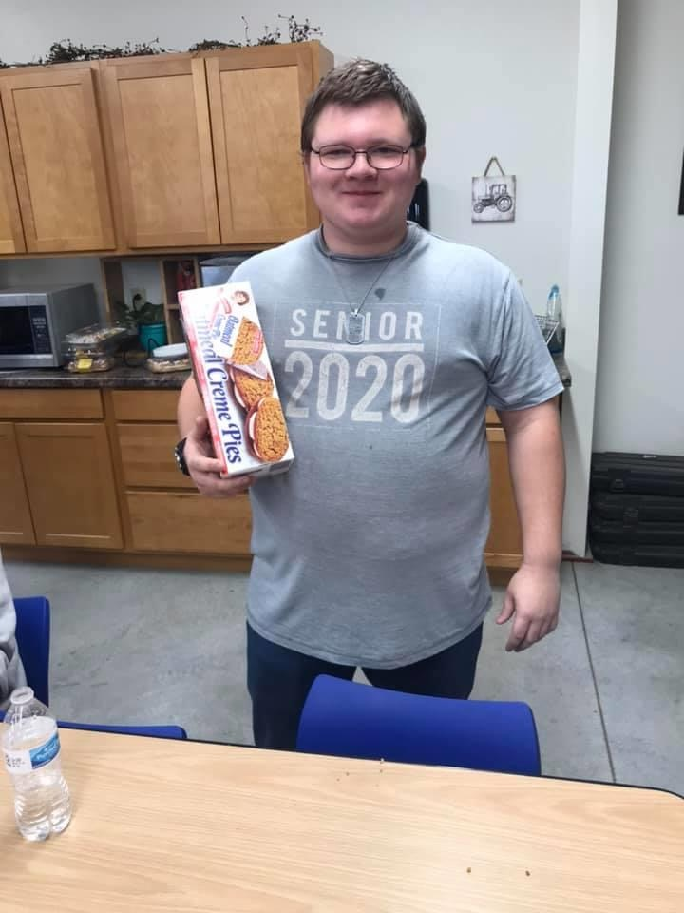
Oatmeal Pie eating contest. Winner was Thomas Herr!

Slide 11
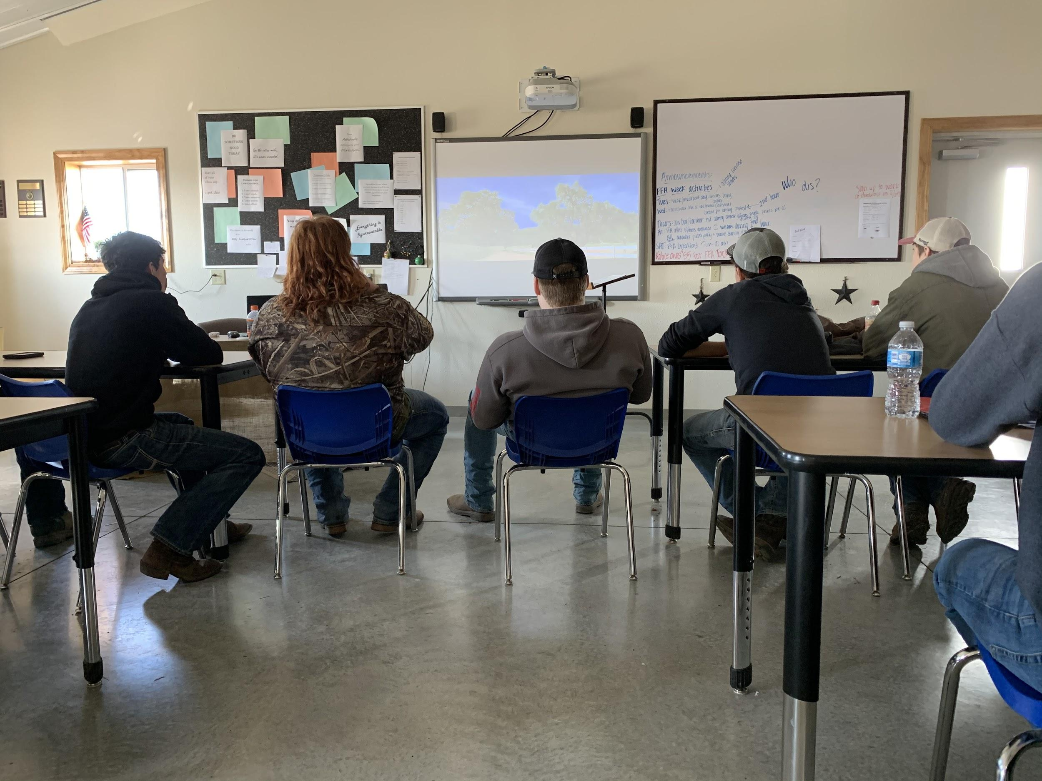
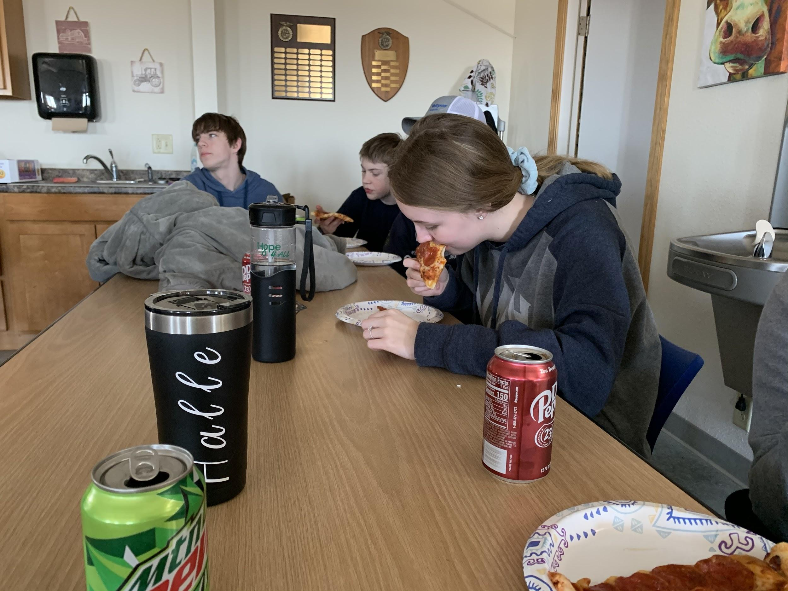
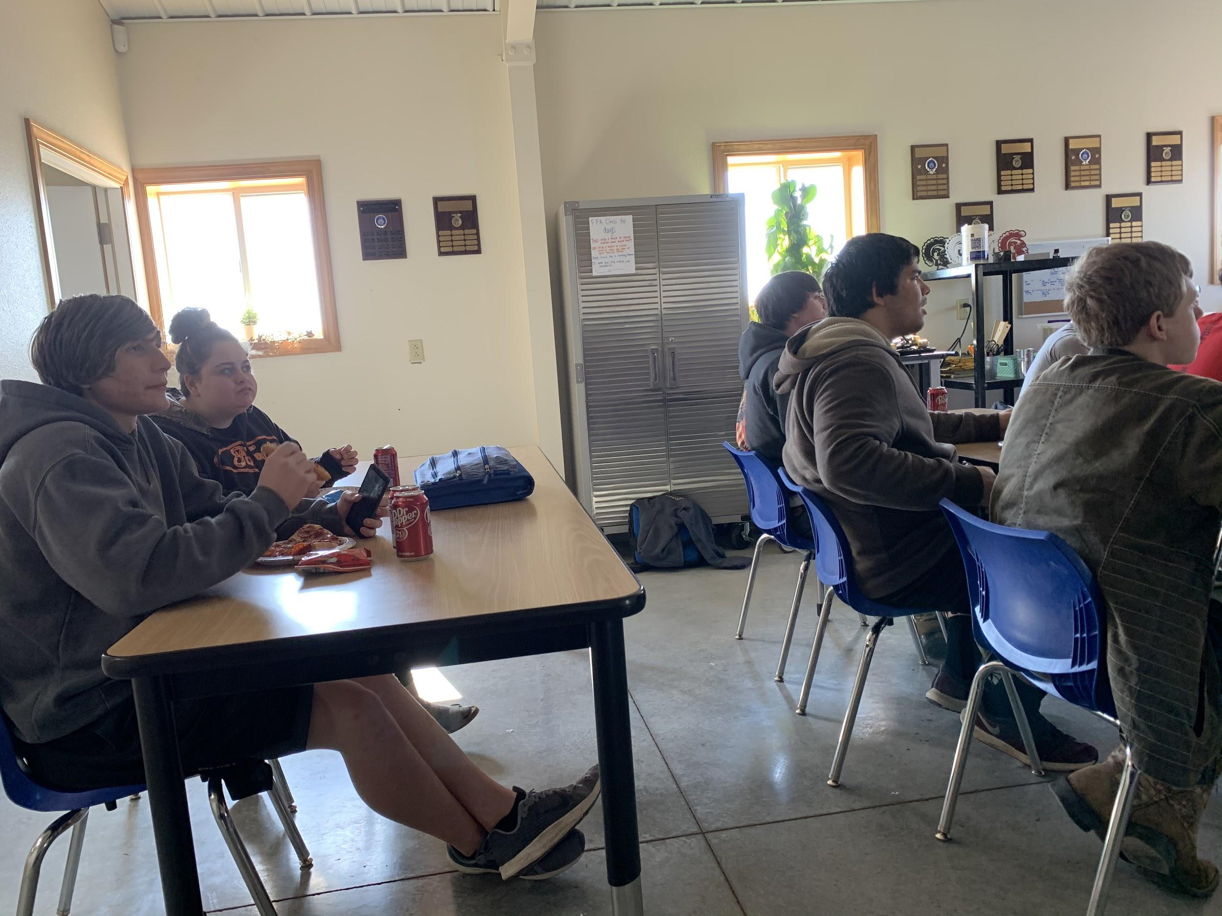
Movie and Pizza

Slide 12
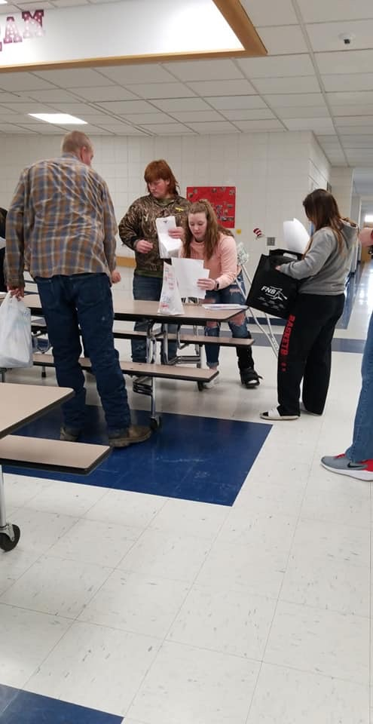
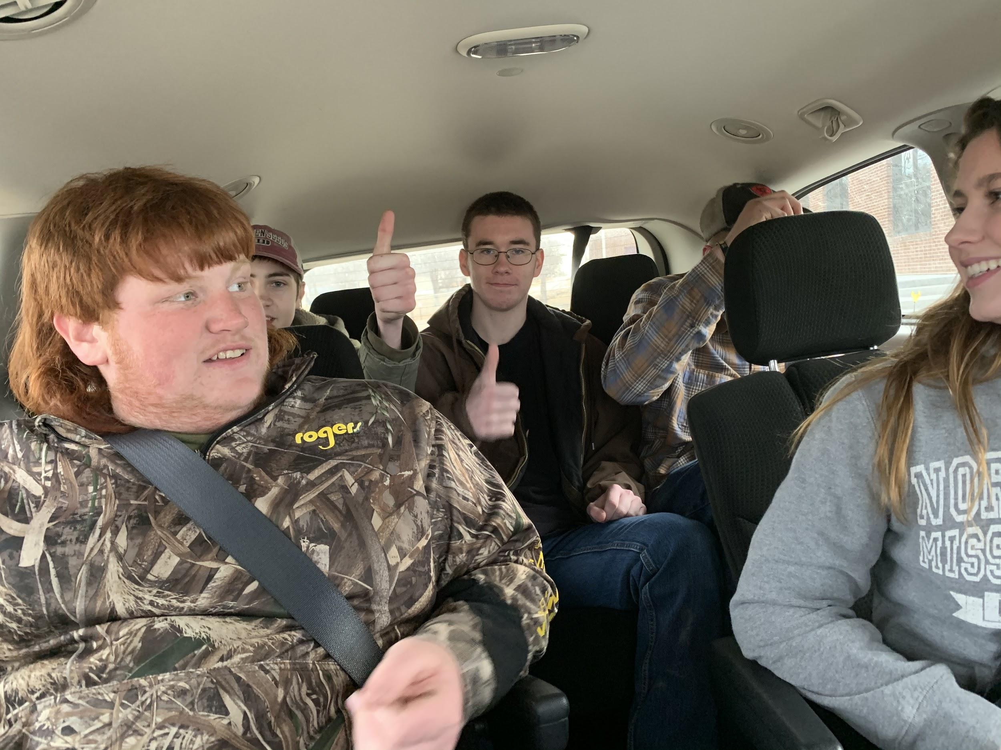
Coloring Contest

Slide 13
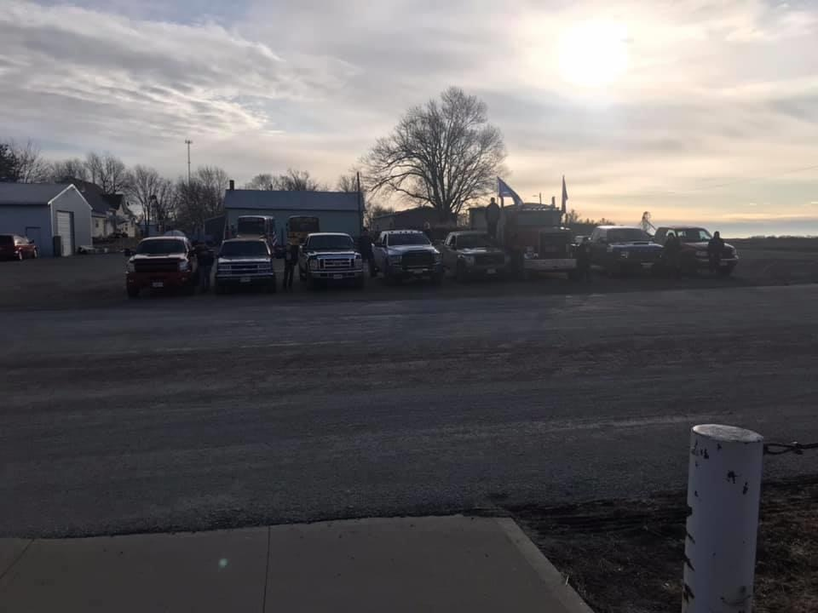
Bring your truck to school day!

Slide 14
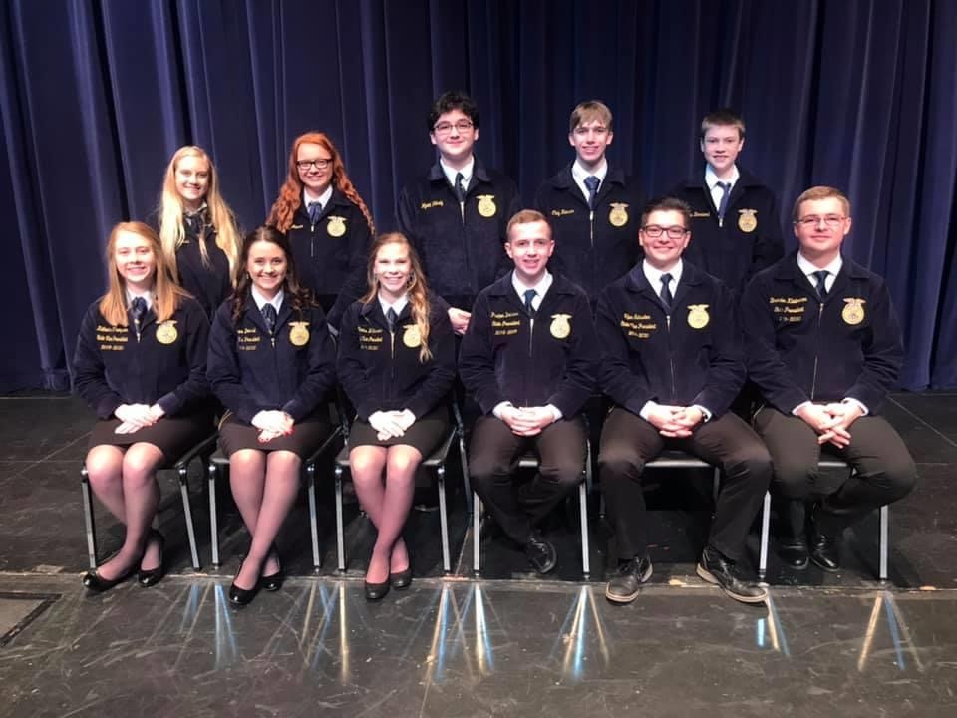
Freshman contest
Morgan Wilmes, Alexis Maurer, Wyatt Wakely, and Clay Hanson

Slide 15
Christmas Party

Slide 16
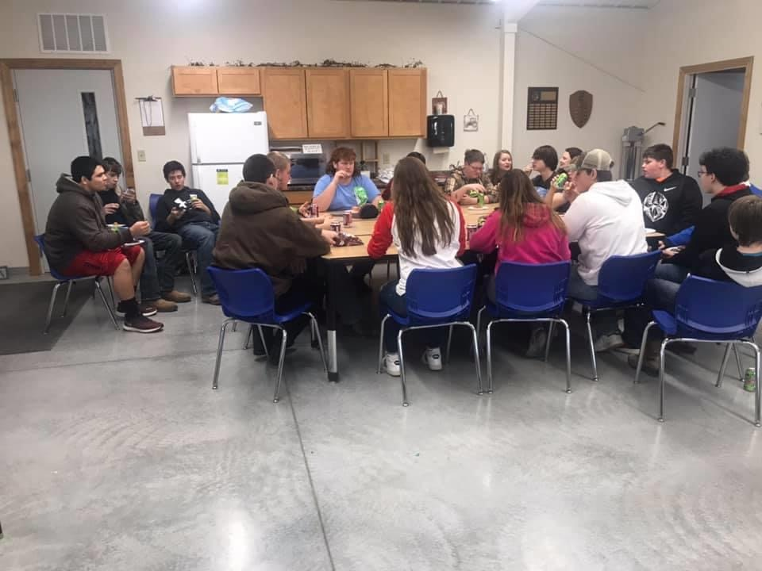
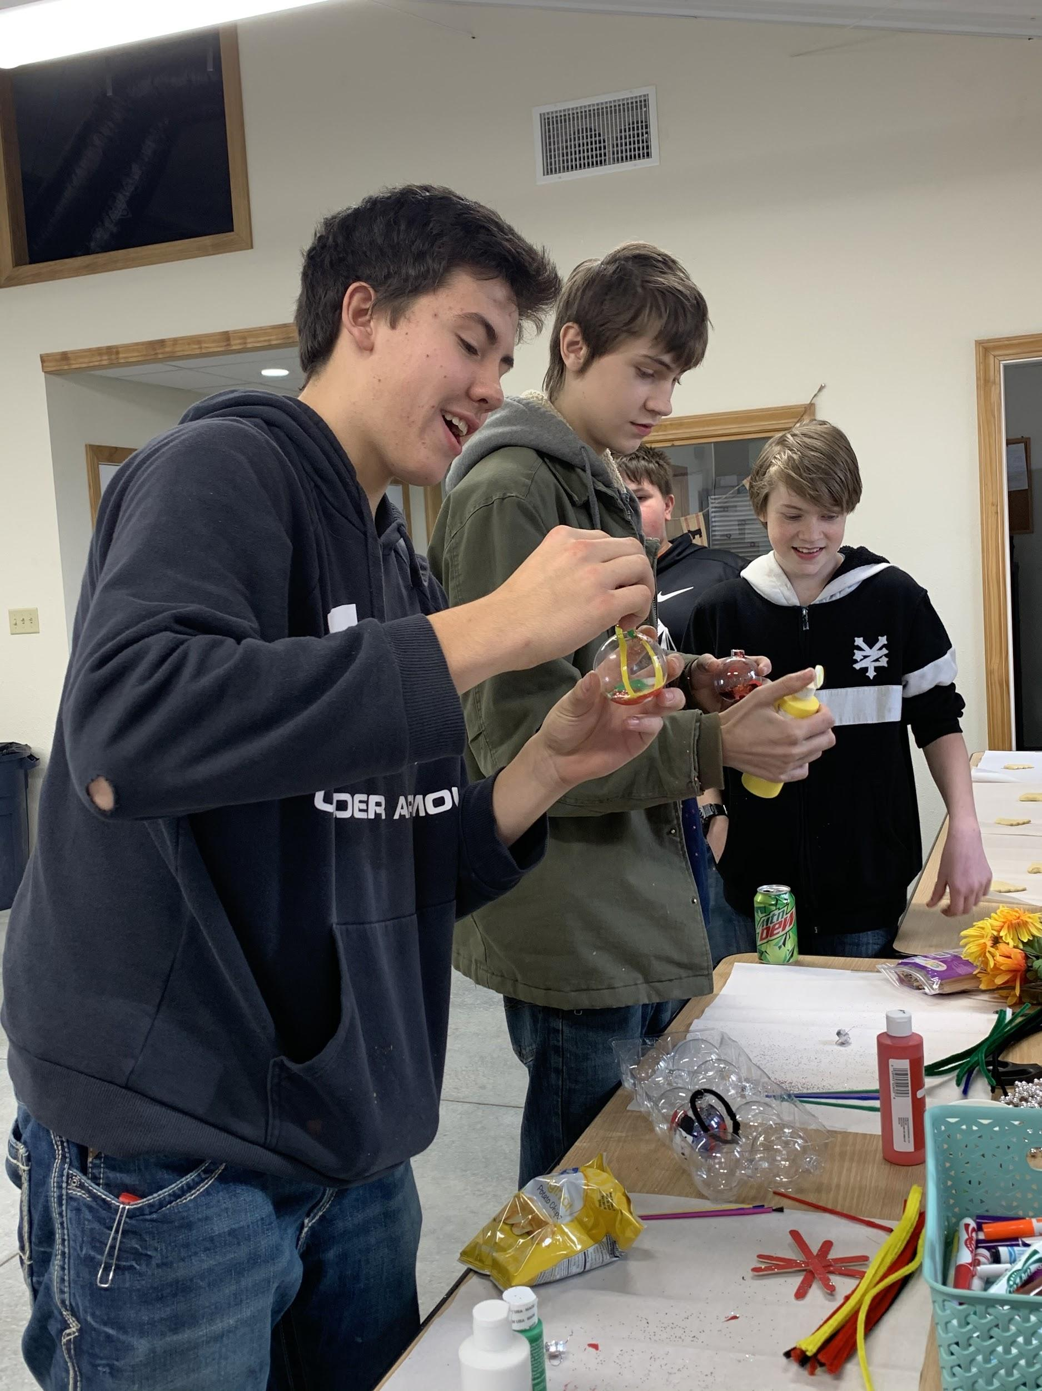
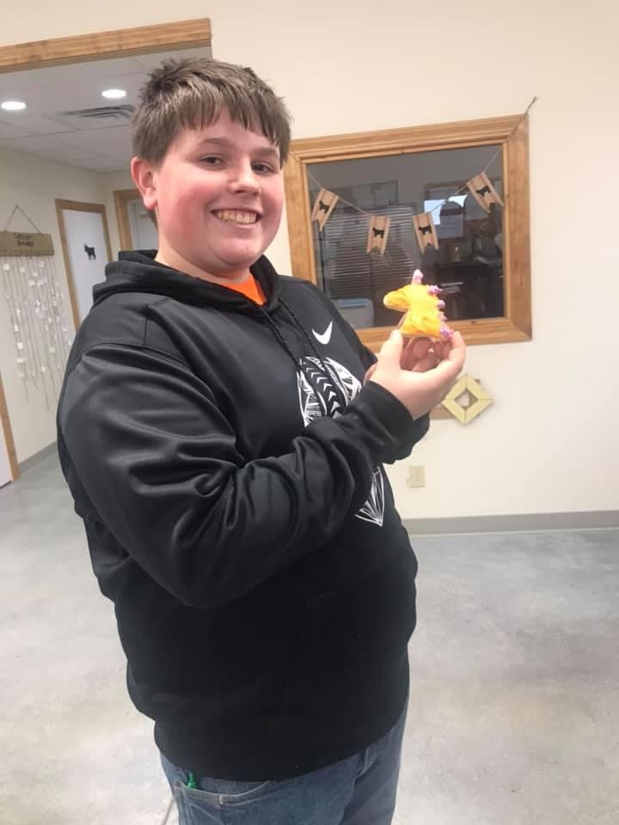

Slide 17
Fruit Sales

Slide 18
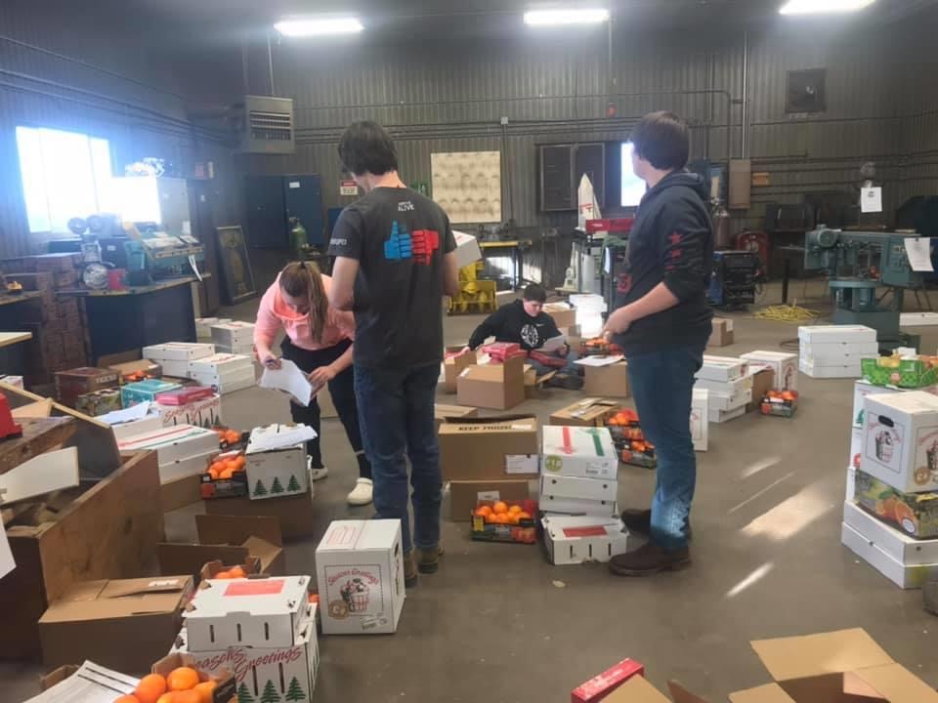
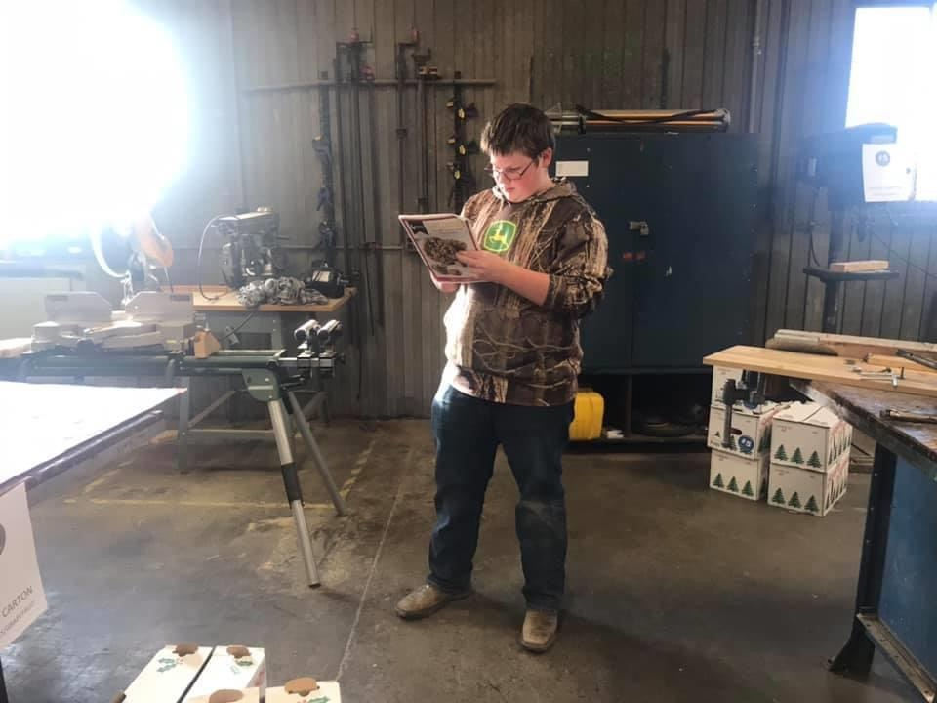

Slide 19
Trap Shooting

Slide 20
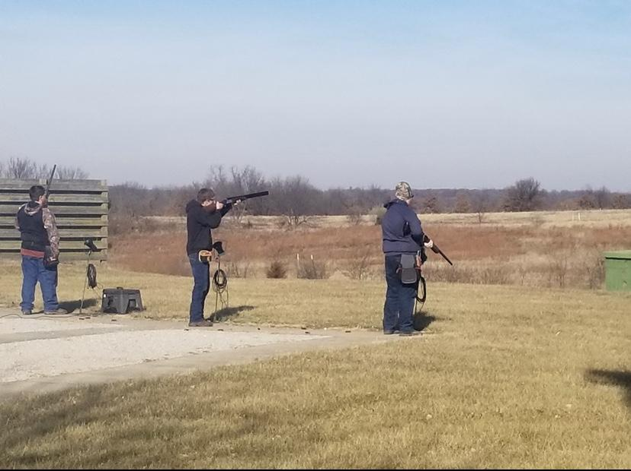
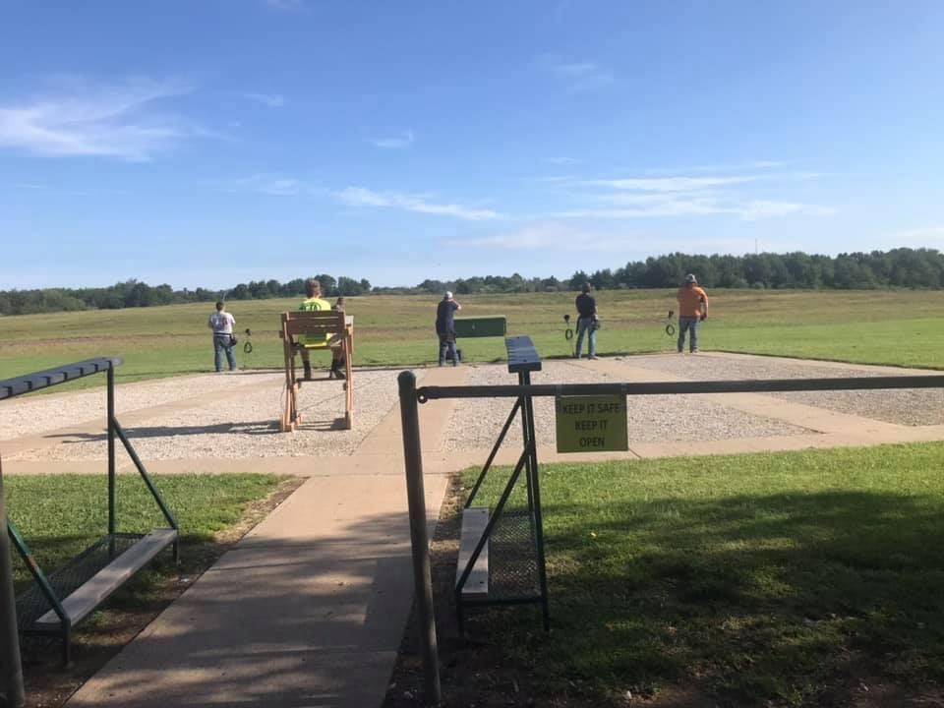
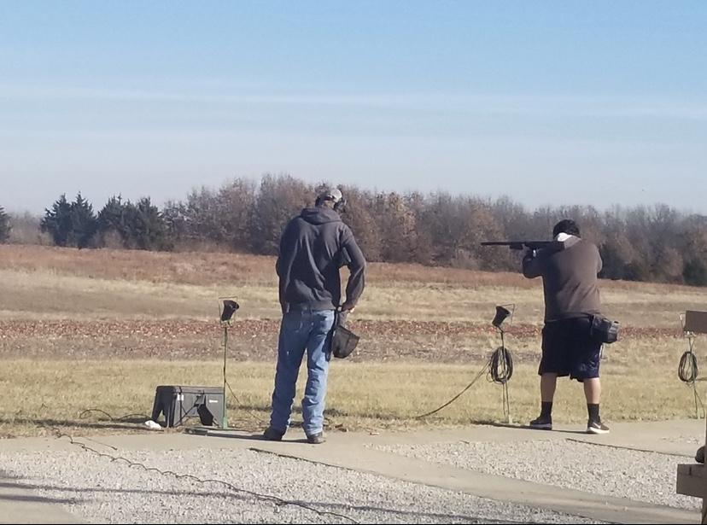

Slide 21
What have some of our members been up to during quarantine?

Slide 22
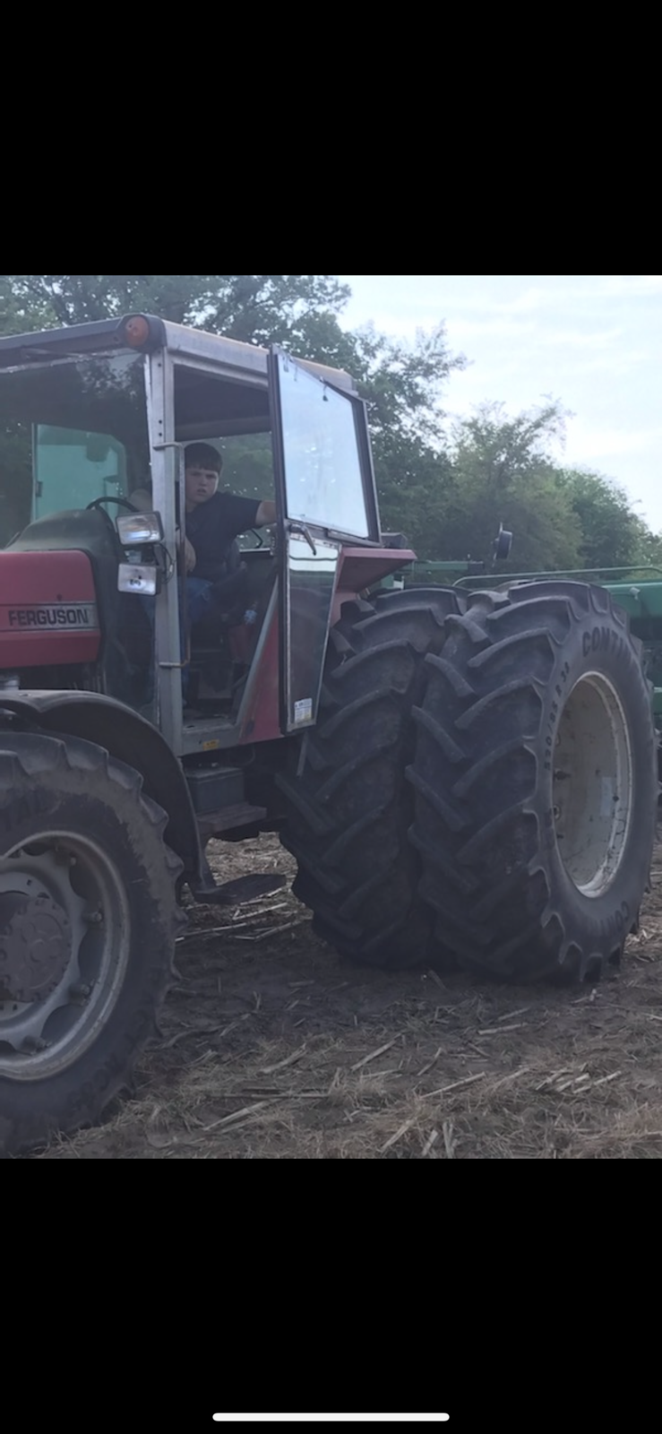
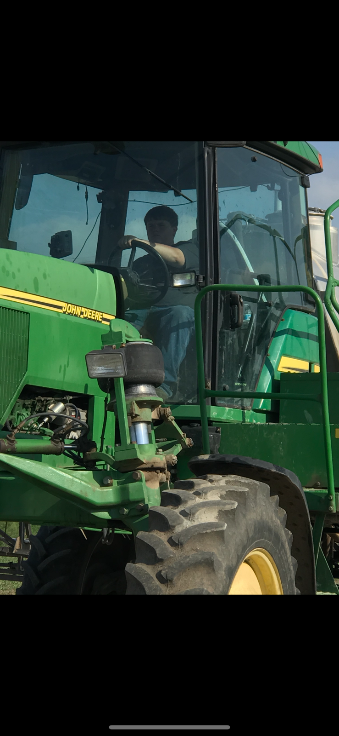
Isaac Johnson has been helping on the farm!

Slide 23
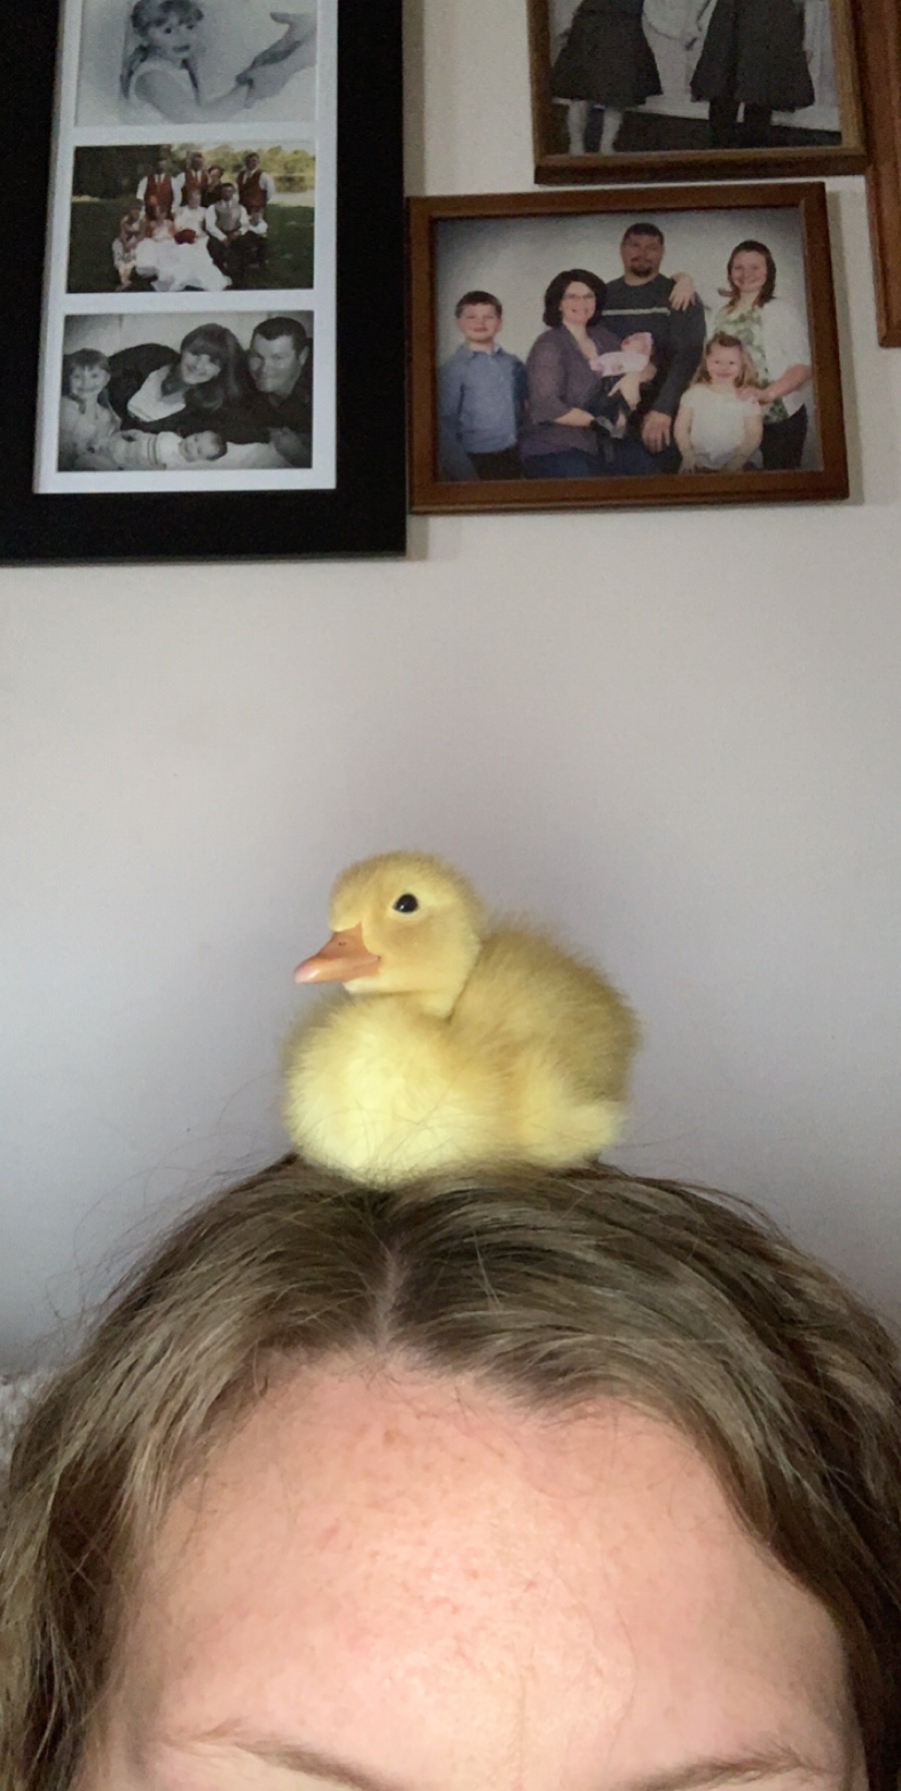
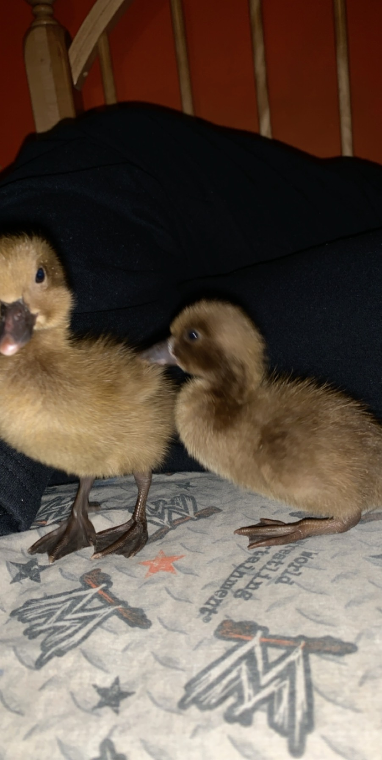
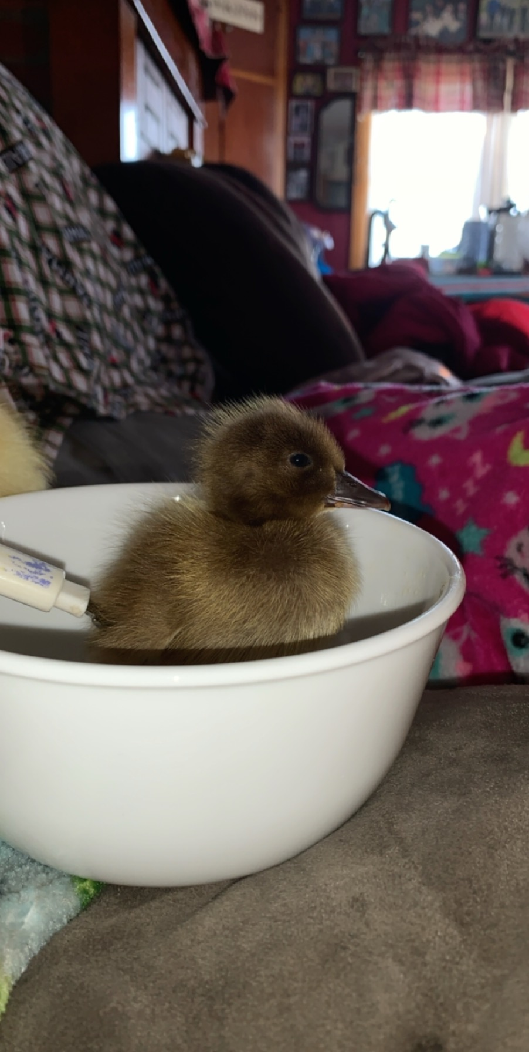
Kloe Jenkins, working on her SAE project, with DUCKS!

Slide 24
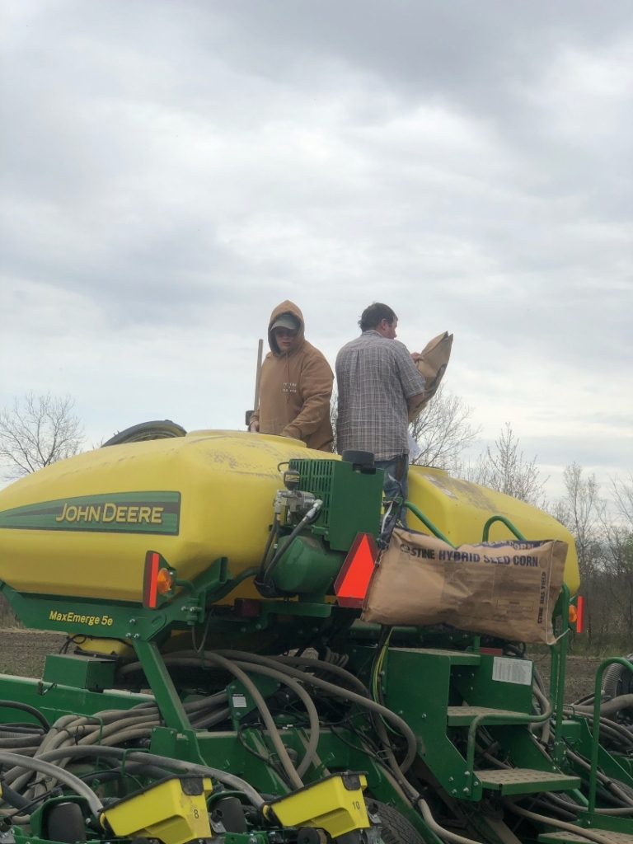
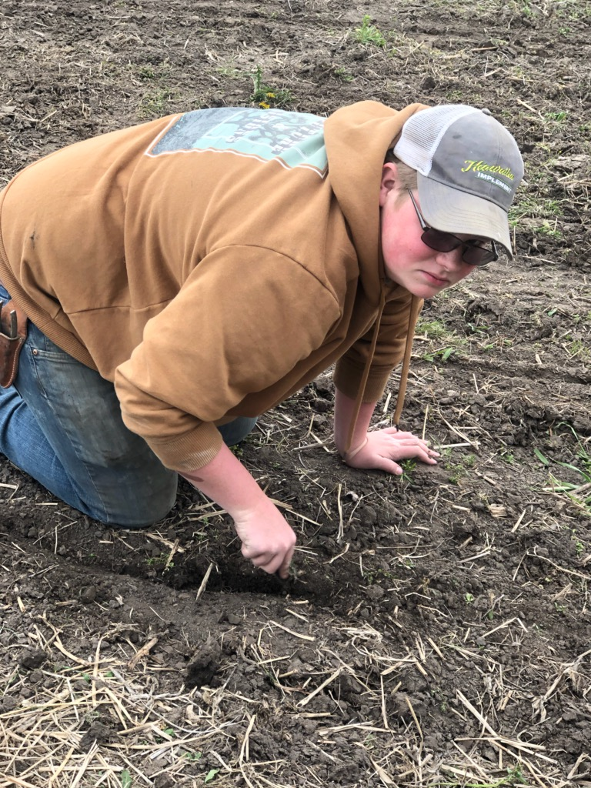
Trent Smock, helping out on the farm

Slide 25
Saying Good luck and Goodbye to our Graduating Officers

Slide 26
Treyton Plummer
Nodaway-Holt FFA Chapter President

Slide 27
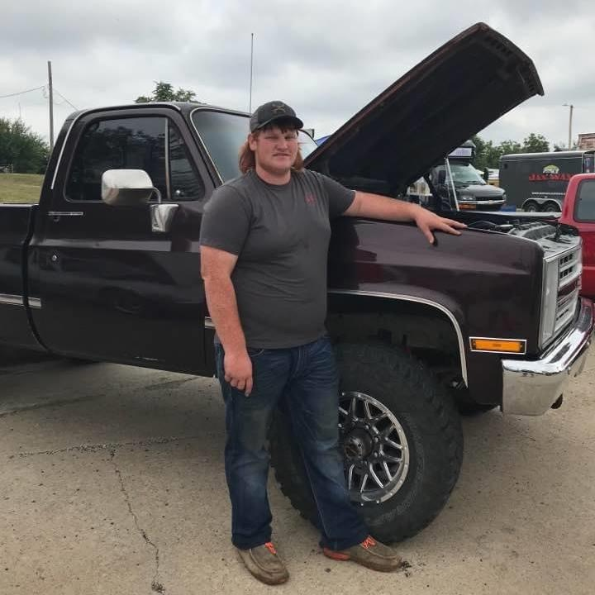
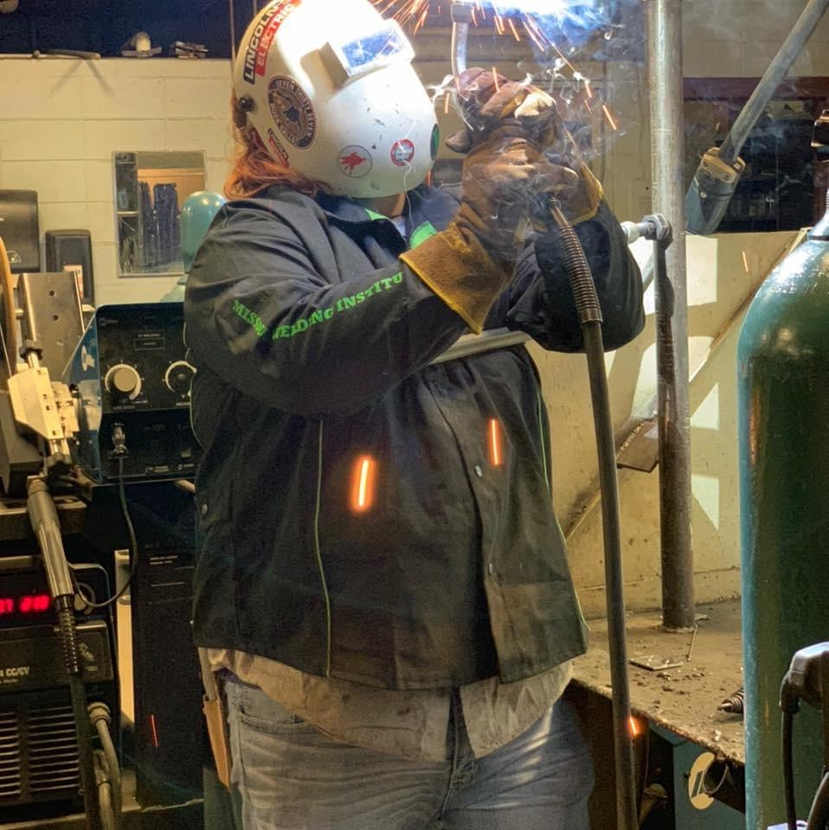
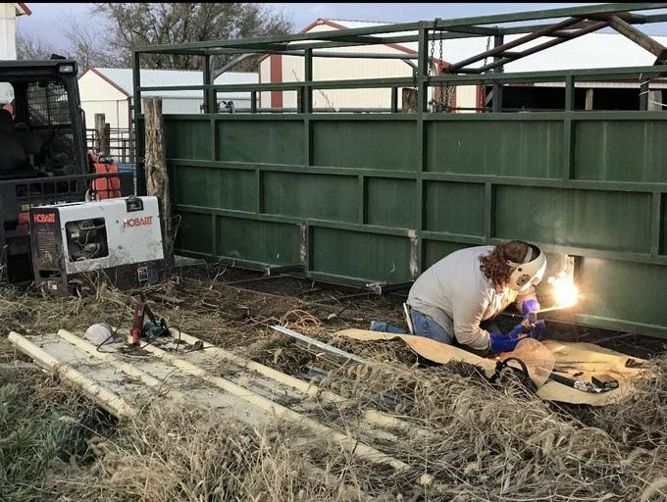

Slide 28
Halle Clement
Nodaway-Holt FFA Chapter Vice President

Slide 29
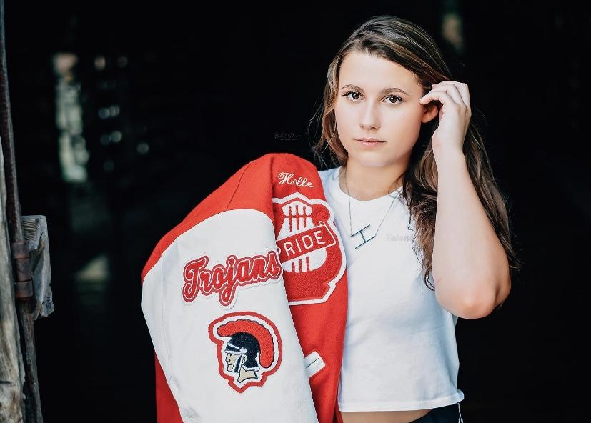
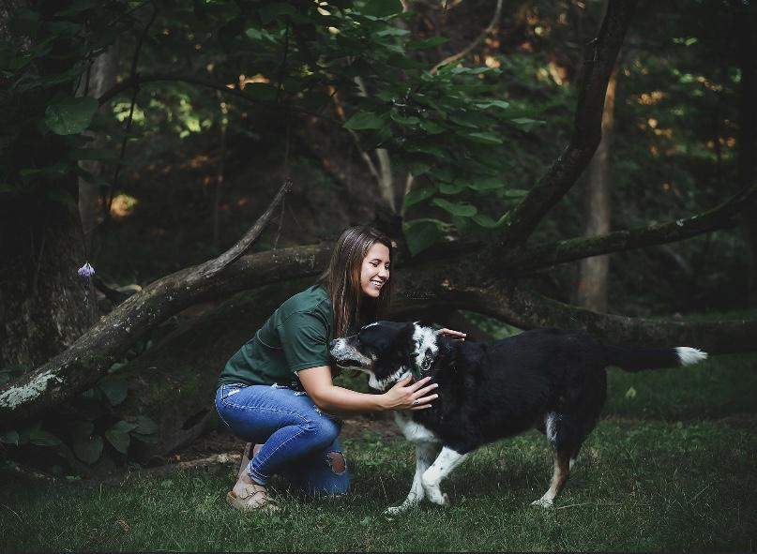
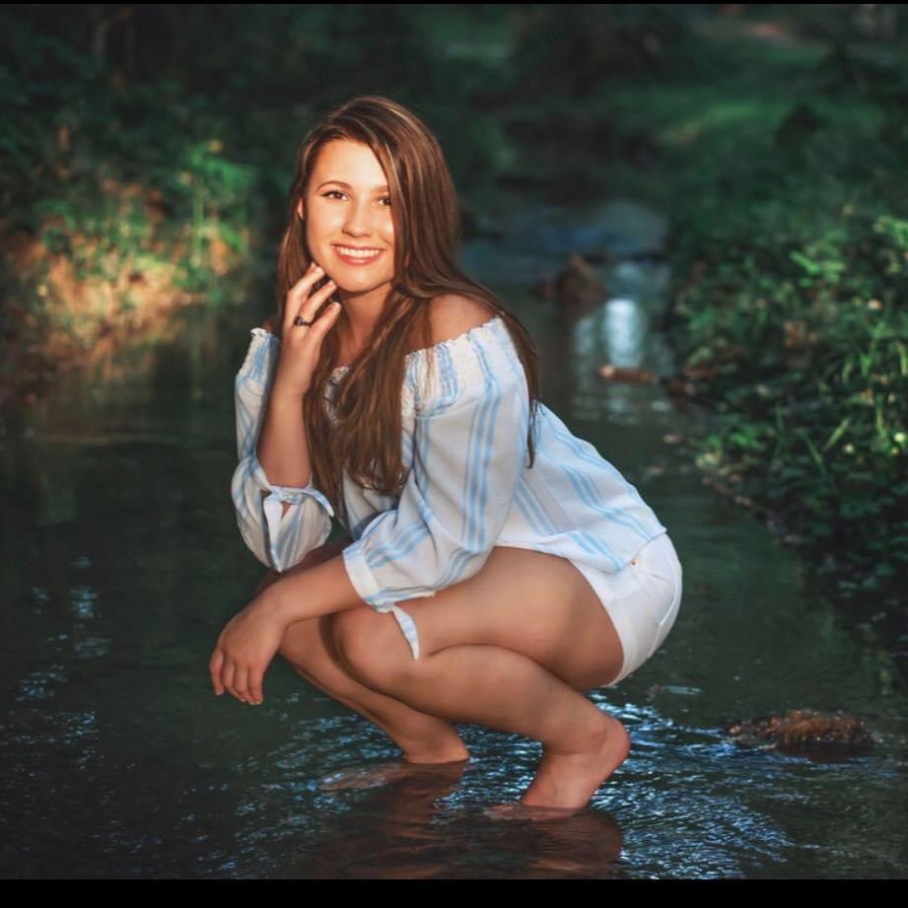

Slide 30
You might grow out of your jacket, but you will NEVER outgrow the experiences.
Thank you for the memories and the leadership you have shown.
---
Nodaway - Holt FFA Chapter

